Slide 1
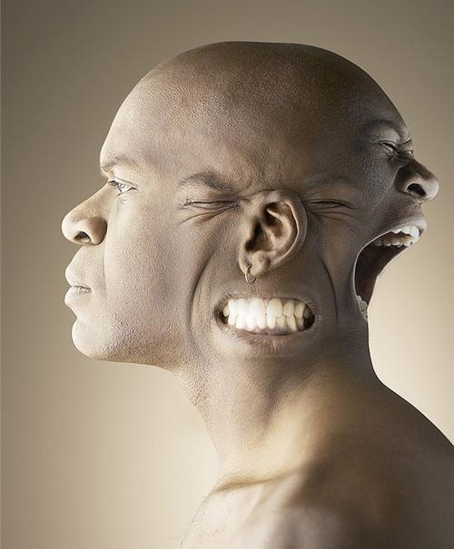
Psychodynamic Theory of Personality

Slide 2
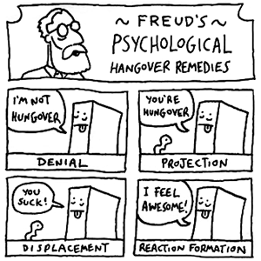
Defense Mechanisms
The ego must protect you from threatening thoughts in our unconscious
Enter “defense mechanisms”
Methods used to reduce or redirect anxiety by distorting reality
You are usually unaware they are occurring
http://www.youtube.com/watch?v=e-NP__ExSSE

Slide 3
Defense Mechanisms
Repression
Projection
Displacement
Reaction Formation
Regression
Denial

Slide 4
Scenario!
Quarterback of the football team, Simon, is dating the head cheerleader, Paula.
Aww…

Slide 5
Scenario!
Paula dumps Simon and starts dating Ryan, from Chess Club.
Sup.
Simon
Paula
Ryan

Slide 6
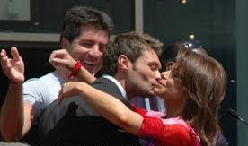
1.) Repression
Pushing thoughts into our unconscious.
When asked about Paula, Simon may say, “Who? I’ve not thought about her for a while.”
Why don’t we remember our Oedipus and Electra complexes?

Slide 7
2.) Projection
Disguises threatening impulses by attributing them to others. Thus, “She doesn’t trust me” may really be “I don’t trust myself”
Simon insists that Paula doesn’t trust him and that is the problem but Simon really doesn’t trust himself.

Slide 8
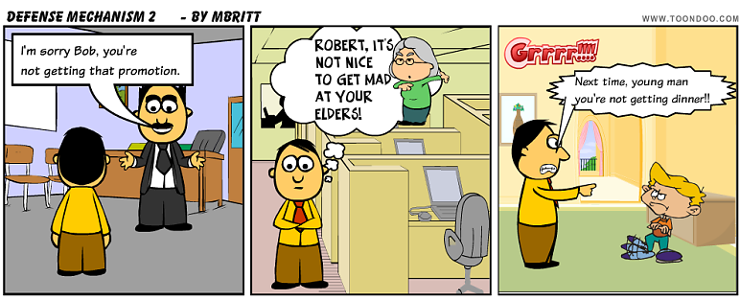
3.) Displacement
Redirecting one’s feelings toward another person or object.
Often displaced on less threatening things.
Children who fear expressing anger against their parents may displace it by kicking the family pet.
Student upset over a test score may snap on a friend.

Slide 9
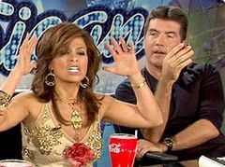
4.) Reaction Formation
Cootie stage in Freud’s Latent Development
Process of pushing away threatening impulses by making unacceptable impulses look like their opposites.
“I hate Paula” but really means “I love Paula”

Slide 10
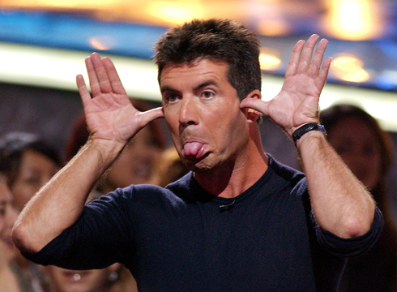
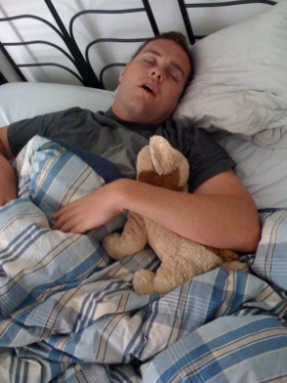
5.) Regression
Returning to an earlier, comforting form of behavior
Simon throws a temper tantrum when Paula breaks up with him.
Brandon begins to sleep with a stuffed animal from his childhood to cope with his mother passing.
← That’s Brandon.

Slide 11
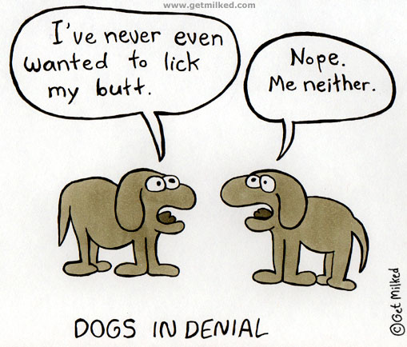
6.) Denial
Not accepting the ego-threatening truth
Simon may act like he is still together with Paula. He may hang out by her locker and plan dates with her.

Slide 12
Practice!
Have Freudian concepts registered in your unconscious? Which Freudian defense mechanisms do the following suggest?

Slide 13
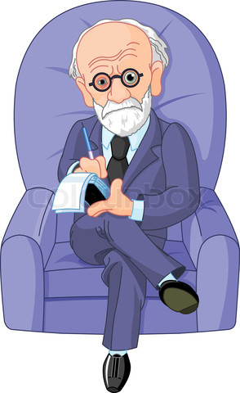
A 6-year-old boy who moves to a new city starts sucking his thumb.
An alcoholic storms out of his intervention because “he doesn’t have a damn drinking problem!”
A man who is angry at his boss shouts at his kids for making noise.
A woman whose father was cruel to
her when she was little insists over
and over that she loves him dearly.
A racist justifies segregation by saying
that black men are only interested
in sex with white women.

Slide 14
How’d You Do??
Regression
Denial
Displacement
Reaction Formation
Projection

