Slide 1
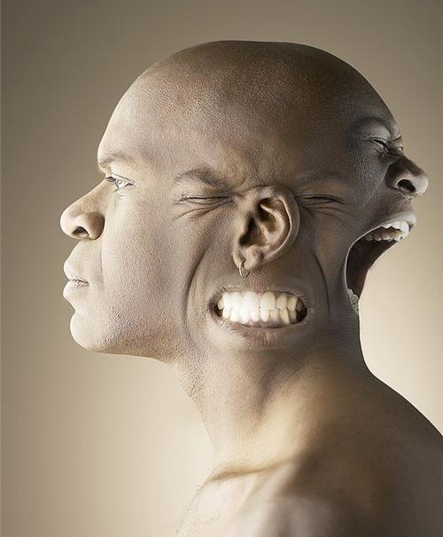
Psychodynamic Theory of Personality

Slide 2
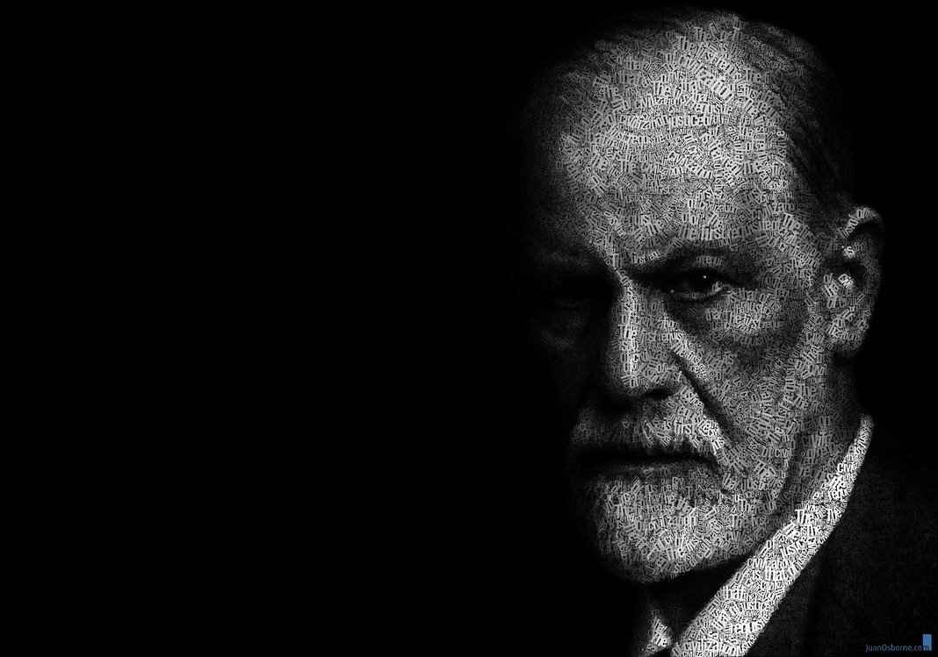
Psychodynamic Perspective
Unconscious: most of our behavior is determined by motives that we are unaware of.
Example: If your blonde father abused you, you may unknowingly harbor hatred for blondes

Slide 3
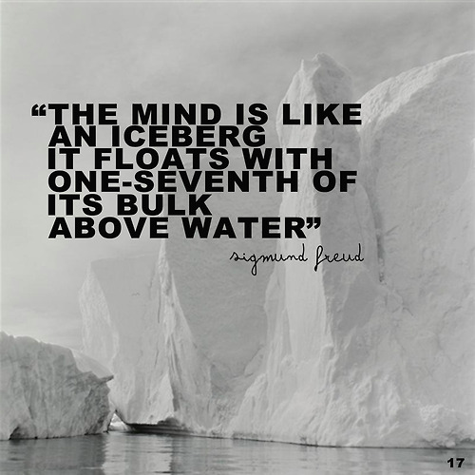

Slide 4
Psychodynamic Perspective
Conscious: things we are aware of
Preconscious: things we can be aware of if we think of them
Unconscious: deep, hidden reservoir that holds our “true” self—all of our fears and desires

Slide 5
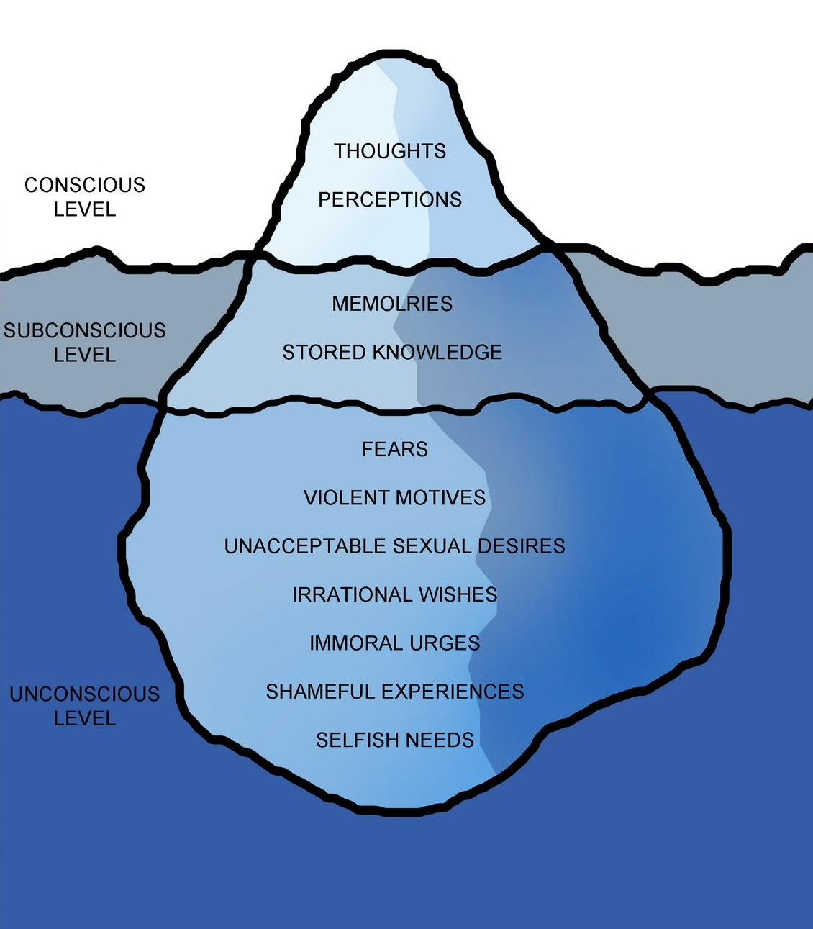

Slide 6
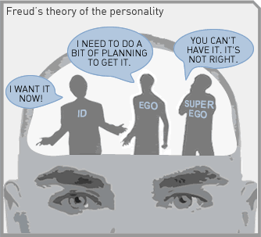
Freud’s Personality Structure
Id: energy striving to satisfy basic drives
Ego: Seeks to gratify the id in realistic ways
Superego: voice of conscious that emphasizes how we ought to behave

Slide 7
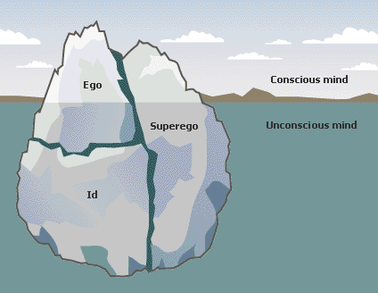
Id, Ego, Superego

Slide 8
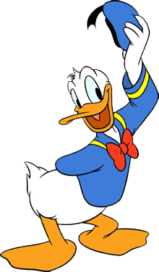
Donald Duck’s Dilemma
http://www.youtube.com/watch?v=tMgpFnycZCg

Slide 9
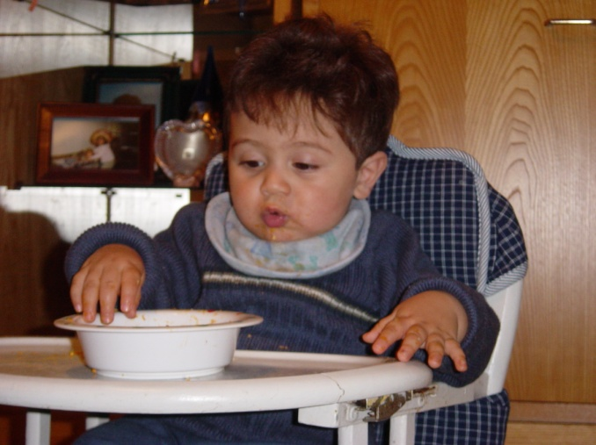
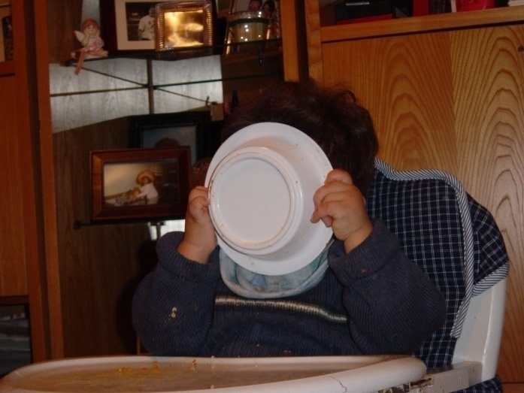
Id
Exists entirely in the unconscious (we are unaware of it)
Our hidden true animalistic wants and desires
Works on the Pleasure Principle
Avoid pain and obtain pleasure

Slide 10
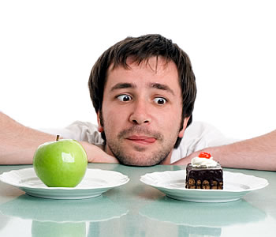
Superego
Develops last at about age 5
This is our conscience
How we differentiate between right and wrong
Your “inner voice”
Pride and satisfaction when you do good; guilt and shame when you break the rules

Slide 11
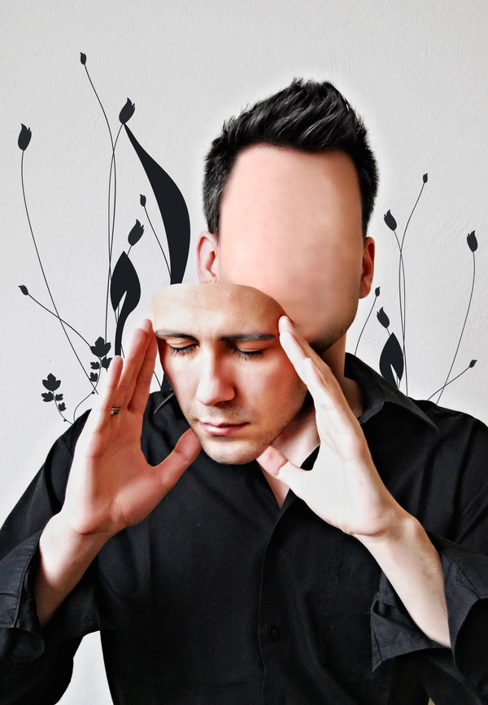
Ego
Develops after the id
Represents “reason and good sense”
Negotiates between the id and the environment
In both our conscious and unconscious minds
THIS is what everyone sees as our personality

Slide 12
“
The Ego is not who you really are. The ego is your self-image; it is your social mask; it is the role you are playing. Your social mask thrives on approval. It wants control, and it is sustained by power, because it lives in fear.
”
--Deepak Chopra

Slide 13
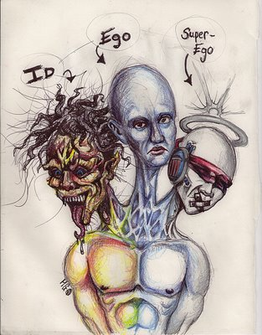

Slide 14
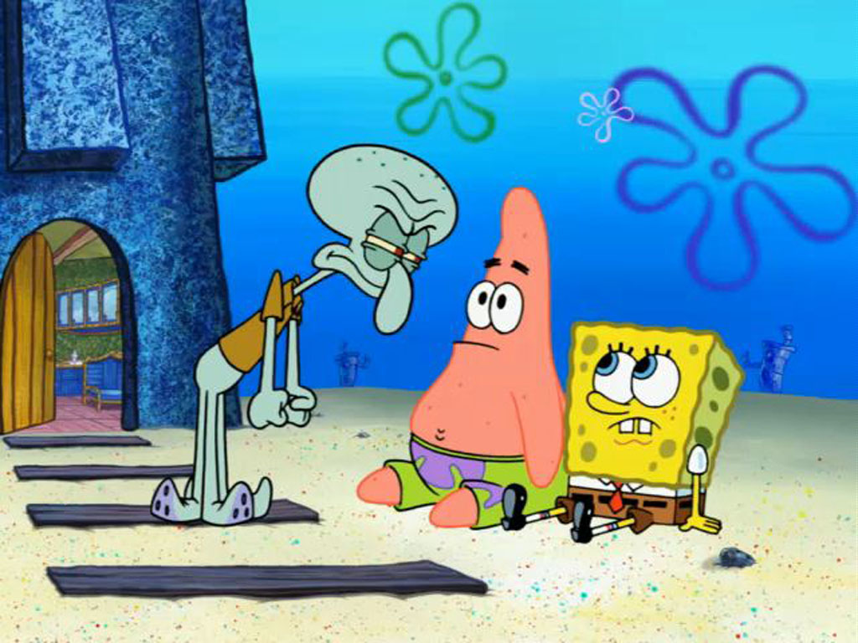
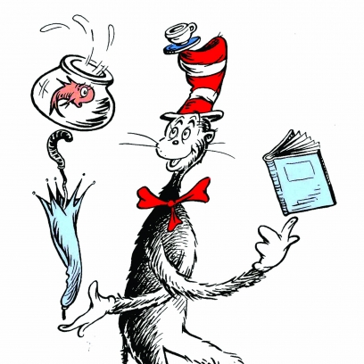
In Entertainment…
https://www.youtube.com/watch?v=ViWoqIB2udA

