Slide 1
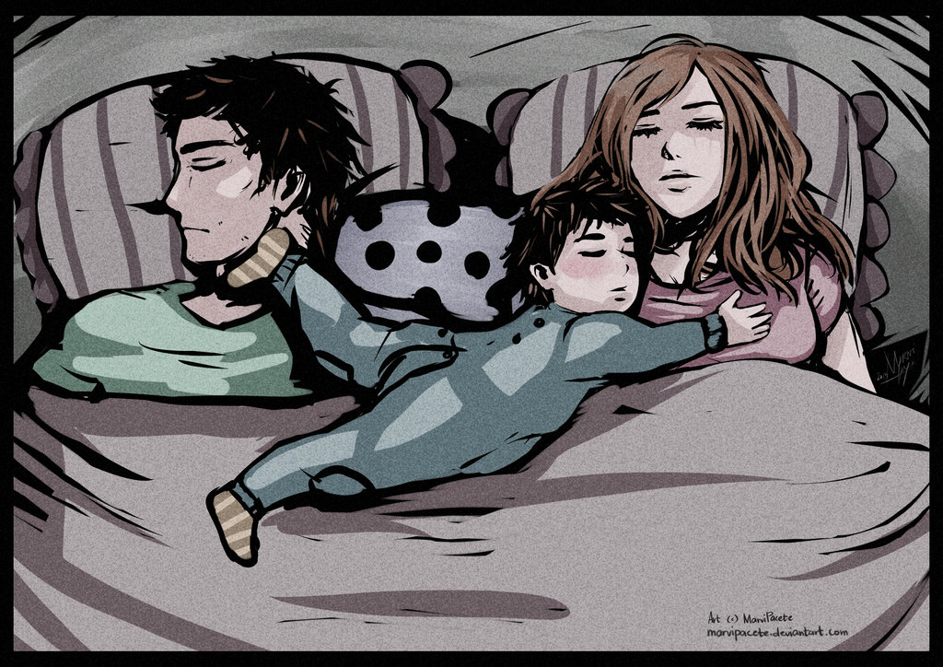
Freud’s Theory of Psychosexual Development
It’s about to get awkward….

Slide 2
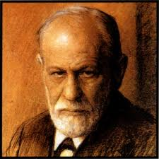
Theory of Psychosexual Development
One of psych’s best-known, and most controversial, theories.
Sigmund Freud
Sexual energy of the id takes different forms as a child matures
Libido = driving force behind behavior

Slide 3
5 Stages of Psychosexual Development
Oral stage
Anal stage
Phallic (Oepdial/Electra) stage
Latency stage
Genital stage
Each stage produces frustration, conflict, and anxiety. If not resolved properly, normal development may be interrupted, and a child may remain fixated, or stuck, at a current stage.

Slide 4
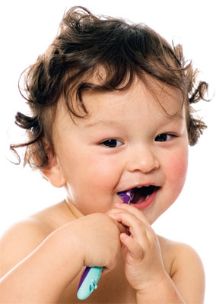
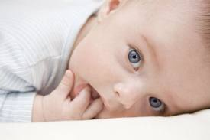
1.) Oral Stage
0-18 months
Stimulation of the mouth produces pleasure
Babies experience world through their mouth
Fixated = smoking, overeating, nail biting, & chewing on pencils as adults

Slide 5
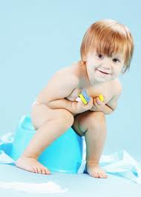
2.) Anal Stage
18-36 months
Stimulating of anal region produces pleasure
Toddlers experience conflict over toilet training
Fixated = “anal retentive” OR “anal expulsive”
Holding everything in, Obsessive about neatness and cleanliness
Messy & disorganized

Slide 6
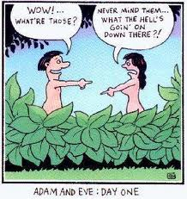
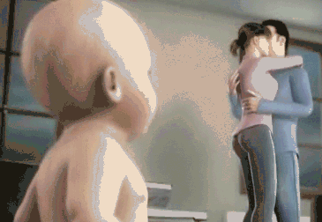
3.) Phallic (Oedipal) Stage
3-6 years
Most crucial stage
Self-stimulation of the genitals produces pleasure
Oedipus/Electra Complex
Boys → pride and pleasure in having a penis
Girls → “penis envy”
At the end of Phallic stage, personality is fundamentally formed

Slide 7
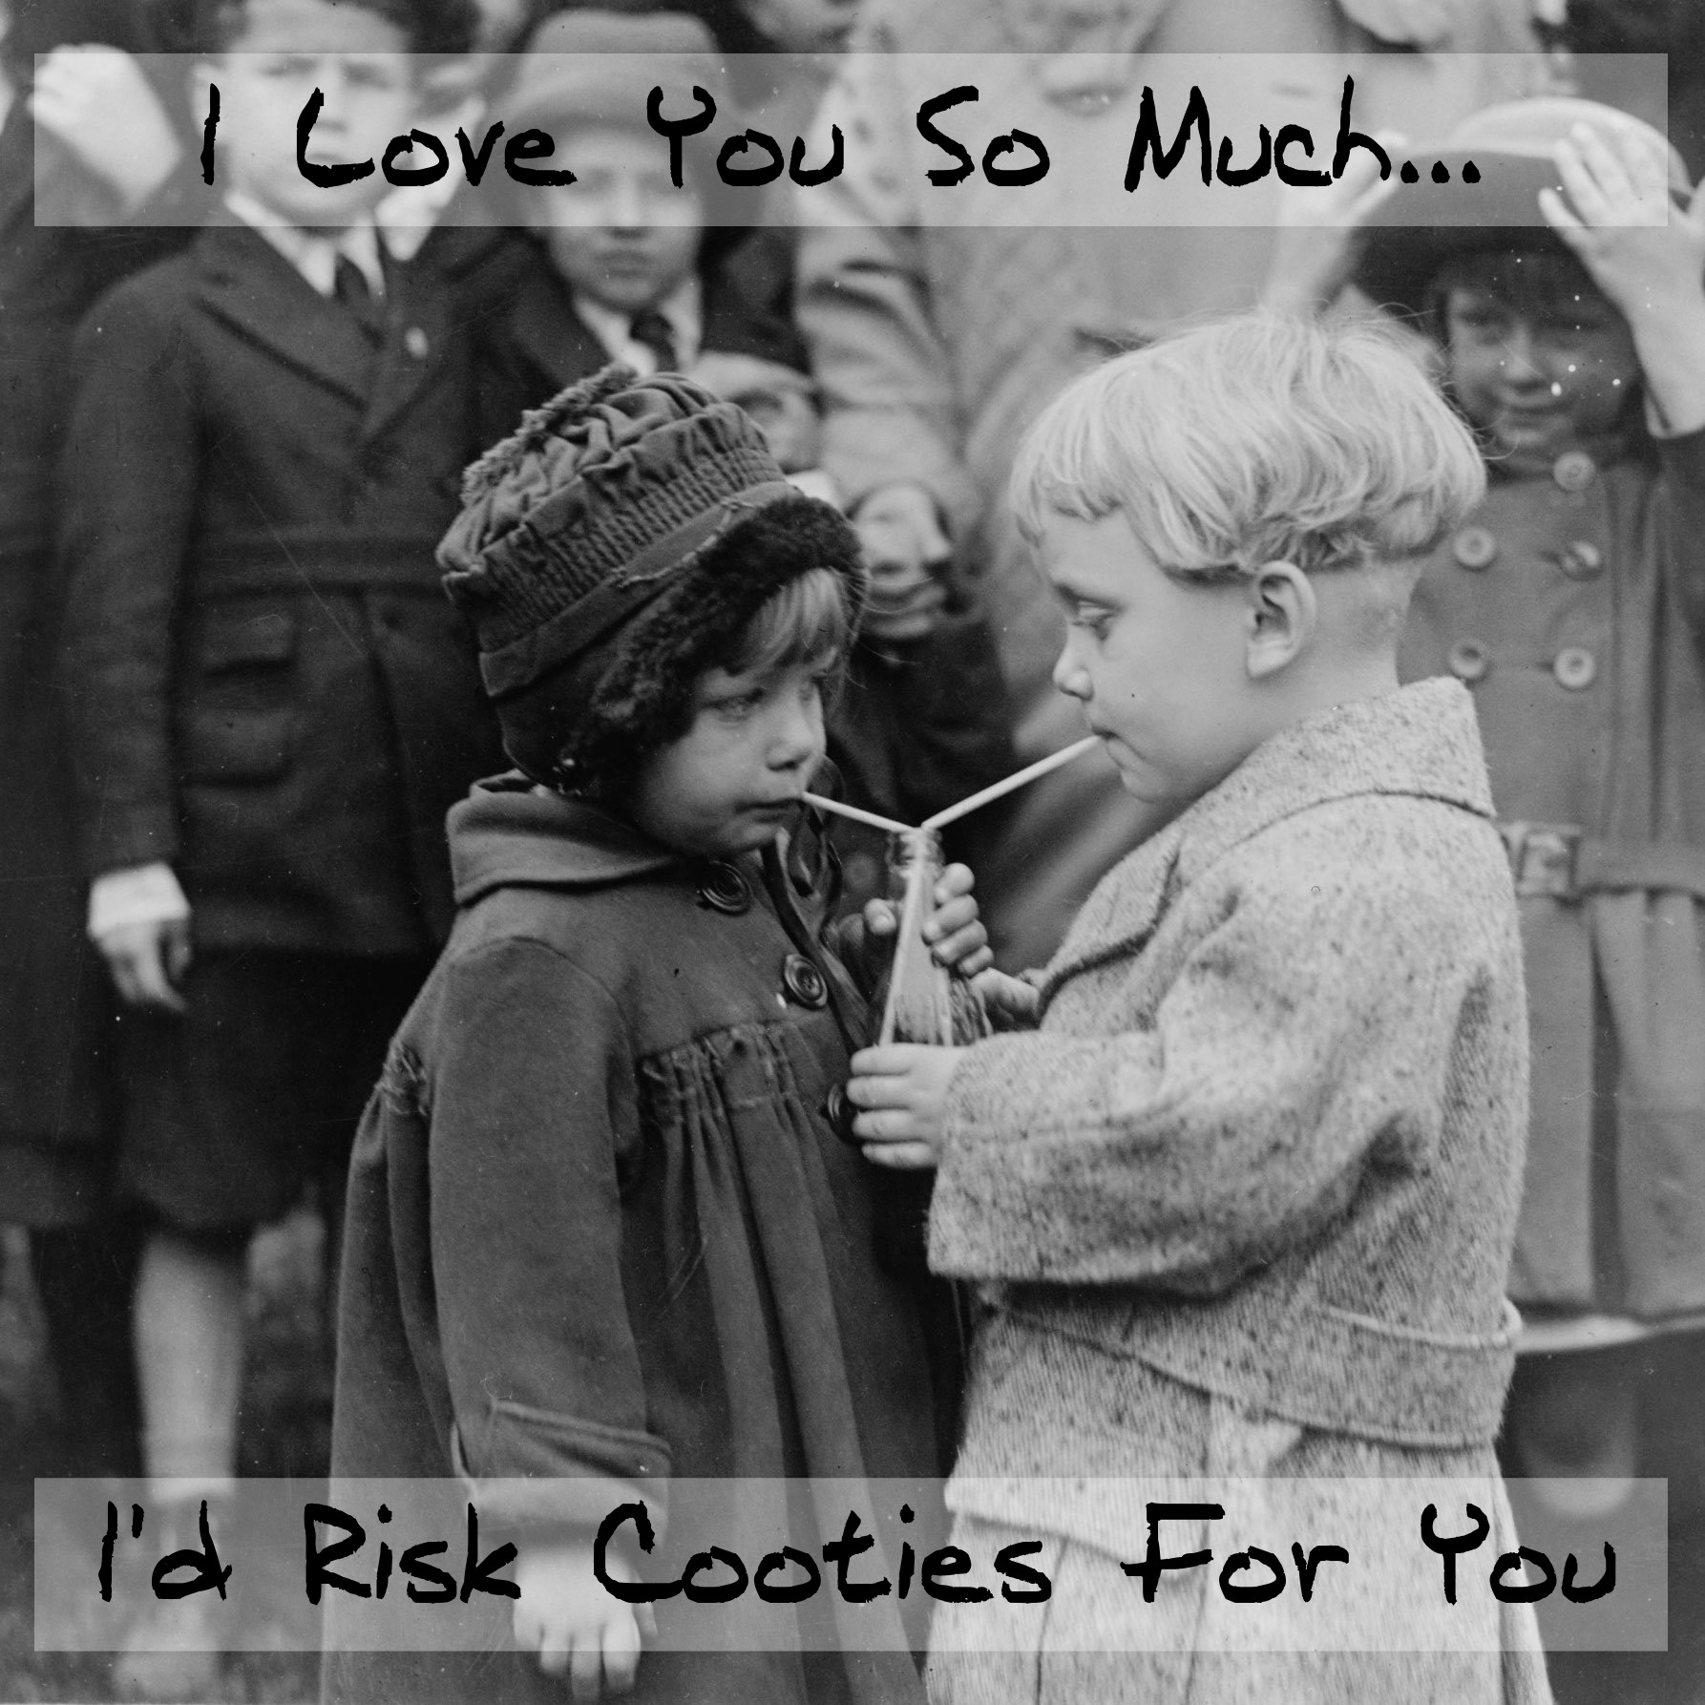
4.) Latency Stage
6 years – puberty
Sexual feelings exist, but are not yet developed or shown
Child avoids members of the other gender
“Cootie stage”

Slide 8
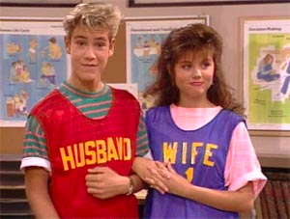
5.) Genital Stage
Puberty Onward
Adolescent adult has mature sexual feelings and experiences pleasure from sexual relationships with others.

Slide 9
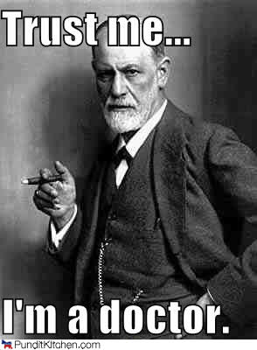
Personality
Freud believed your adult personality is shaped by…
how you progressed through the early psychosexual stages,
which defense mechanisms you developed to reduce anxiety, and
whether your ego is strong enough to balance the conflict between your id (what you would like to do) and your superego (your conscience)

