Slide 1
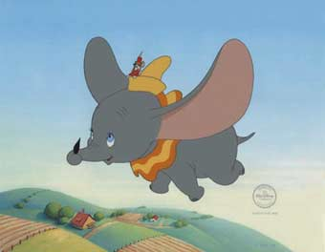
Hearing
AKA: Audition

Slide 2
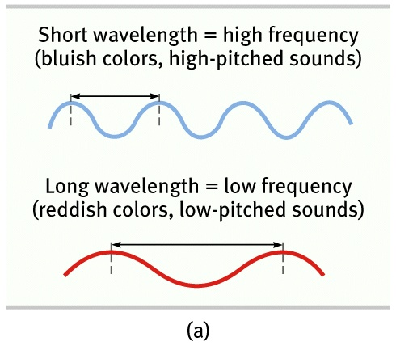
Frequency the number of complete wavelengths that pass through point at a given time. This determines the pitch of a sound.

Slide 3
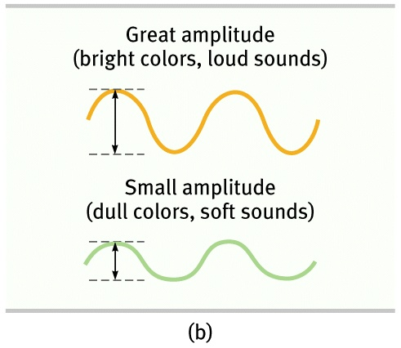
Amplitude is how loud the sound is. The higher the crest of the wave is the louder the sound is. It is measured in decibels.

Slide 4
Amplitude is how loud the sound is. The higher the crest of the wave is the louder the sound is. It is measured in decibels.

Slide 5
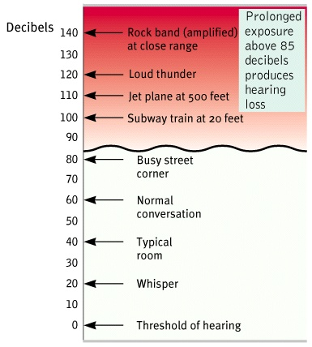

Slide 6
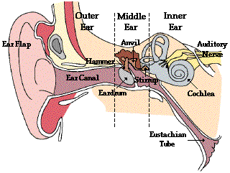

Slide 7
How do we perceive differences in pitch?
There are two theories……..

Slide 8
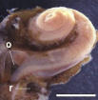
Helmholtz’s Place Theory
We hear different pitches because different sound waves trigger activity at different places along the cochlea’s basilar membrane.

Slide 9
Frequency Theory
We sense pitch by the basilar membrane vibrating at the same rate as the sound.
But this theory has trouble explaining high pitch sounds because our hairs cannot vibrate at certain speeds.
This problem can be explained using the volley principle.

Slide 10
Why do we have two ears?

Slide 11
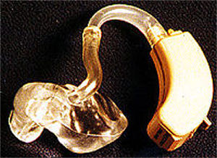
Hearing loss
Conduction Hearing Loss: caused by damage to mechanical system of ear.
Sensorinueral hearing loss: caused by damage to cochlea’s receptor cells or to auditory nerves.

Slide 12
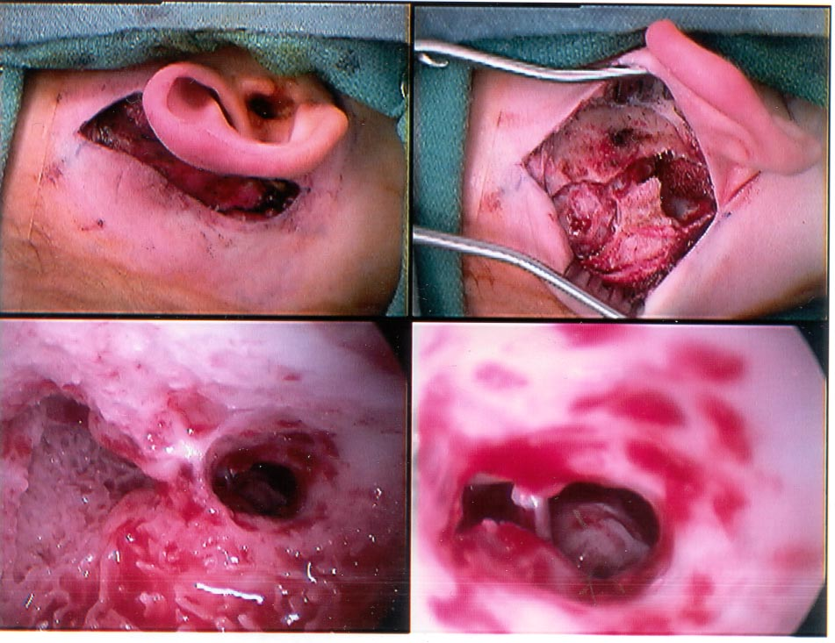

Slide 13
