Slide 1
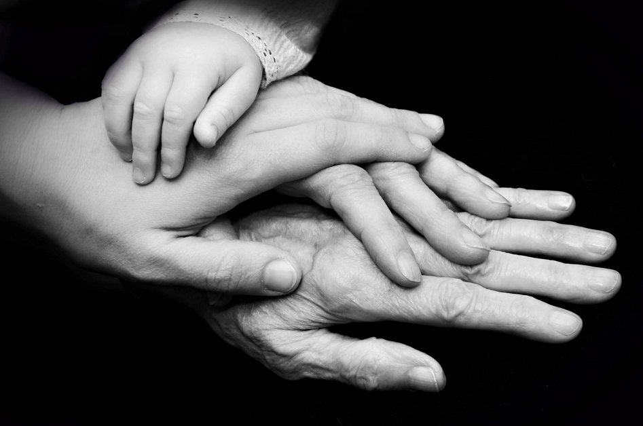
Developmental Psychology

Slide 2
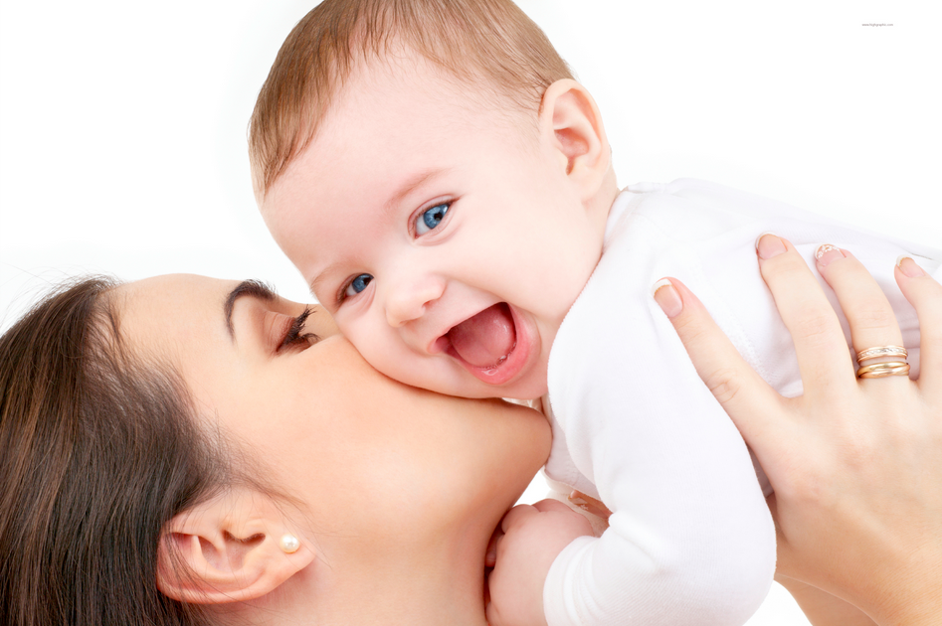
Infant Reflexes & Attachment

Slide 3
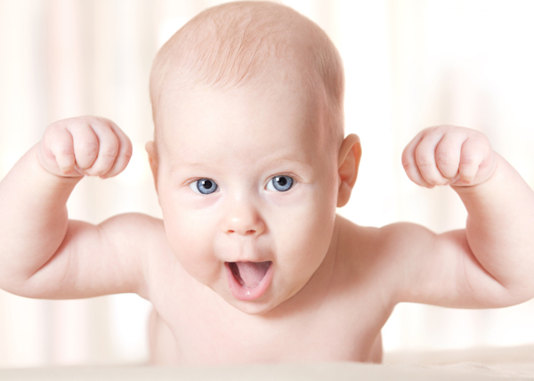
The Infant’s World
Many abilities, tendencies, and characteristics are universal in human beings & are present at birth, or soon thereafter.
Newborns begin life with several motor reflexes, or automatic behaviors that are necessary for survival

Slide 4
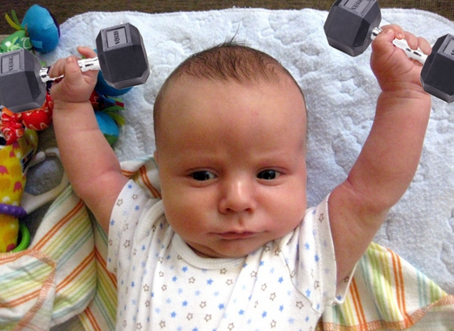
Reflexes of the Newborn Baby
Rooting
Sucking
Swallowing
Moro or “startle”
Babinski
Grasp
Stepping
http://www.youtube.com/watch?v=hDiqATUYjX4

Slide 5
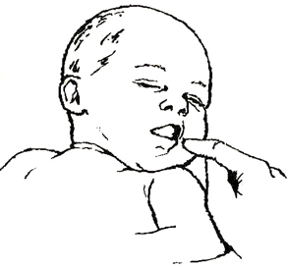
1.) Rooting Reflex
An infant touched on the cheek or corner of the mouth will turn toward the touch and search for something to suck on.

Slide 6
2.) Sucking Reflex
An infant will suck on anything suckable, such as a nipple or finger.

Slide 7
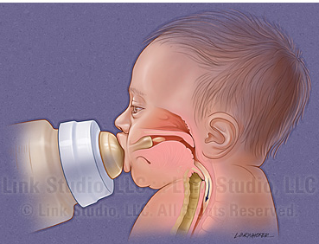
3.) Swallowing Reflex
An infant can swallow, though this reflex is not yet well coordinated with breathing.

Slide 8
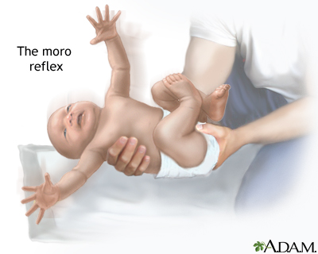
4.) Moro or “Startle”
In response to a loud noise or a physical shock, an infant will throw its arms outward and arch its back.
Also occurs when infant feels as if they’re falling.

Slide 9
5.) Babinski Reflex
1.
In response to a touch on the bottom of the foot, the infant will splay its toes outward and then curl them in.
In adults, toes just curl in.
2.

Slide 10
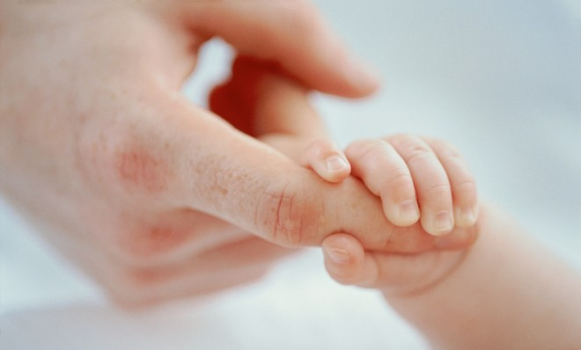
6.) Grasp Reflex
In response to a touch on the palm of the hand, an infant will grasp.

Slide 11
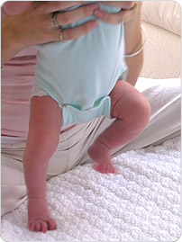
7.) Stepping Reflex
If held so that the feet just touch the ground, an infant will show “walking” movements, alternating the feet in steps.

Slide 12
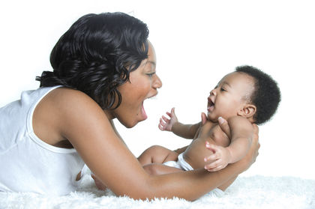
Attachment
Emotional attachment is a universal desire or all primates.
Important for health and survival
Allows child to explore world, but return to safe haven if afraid

Slide 13
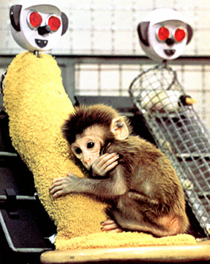
Contact Comfort
Attachment begins with physical touching and cuddling between infant and parent.
Harlow’s Monkeys
Human children, too, seek contact comfort when they are in an unfamiliar situation, scared, or hurt.
http://www.youtube.com/watch?v=hsA5Sec6dAI

Slide 14
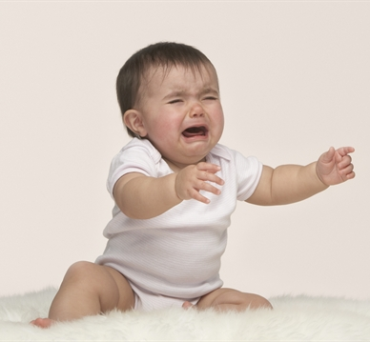
Separation and Security
Once babies are emotionally attached to the mother, separation can be a wrenching experience.
Cry if left left in unfamiliar setting or with a stranger.
Show separation anxiety if primary caregiver leaves them.
The Strange Situation
http://www.youtube.com/watch?v=QTsewNrHUHU

Slide 15
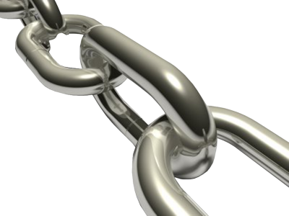
Three Categories of Attachment
Securely attached
Insecurely attached
2a.) Avoidance
2b.) Anxious or ambivalent (having torn feelings)

Slide 16
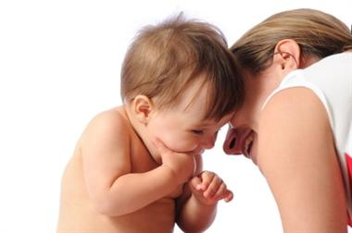
1.) Secure Attachment
Baby cries or protests if the mother leaves the room
Welcomes her back upon return
Happily continues playing

Slide 17
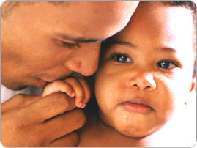
2a.) Avoidance
Not caring if the mother leaves the room
Makes little effort to seek contact with her on upon return
Treating stranger about same to mother

Slide 18
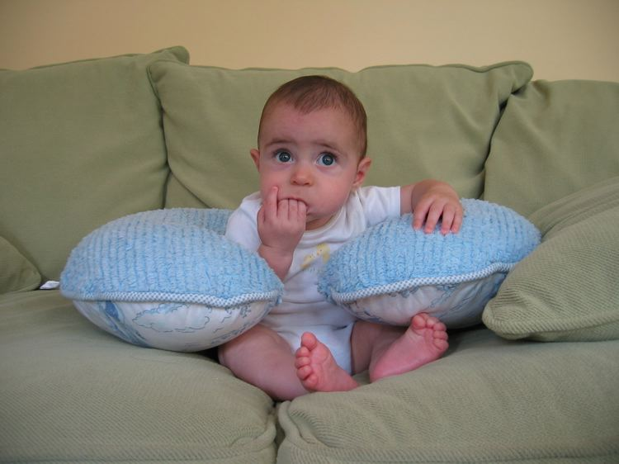
2b.) Anxious or Ambivalent
Resisting contact with mother at reunion
Protests loudly if she leaves
May cry to be picked up, then demand to be put down

Slide 19
What Causes Insecure Attachment?
Abandonment and deprivation in first two years of life
Parenting that is abusive, neglectful, or erratic because parent is chronically irresponsible or depressed.
Child’s own genetically-influenced temperament
Changing, stressful circumstances in the child’s family.

Slide 20
Practice!
Melanie is playing happily on a jungle gym at her child-care center when she falls off and scrapes her knee. She runs to her caregiver for a consoling cuddle. Melanie is seeking __________.
A baby left in the Strange Situation does not protest when his mother leaves the room, and he seems to ignore her when she returns. What style of attachment is this behavior said to reflect?

Slide 21
How’d You Do??
Contact comfort
Insecure (avoidant)

