Slide 1
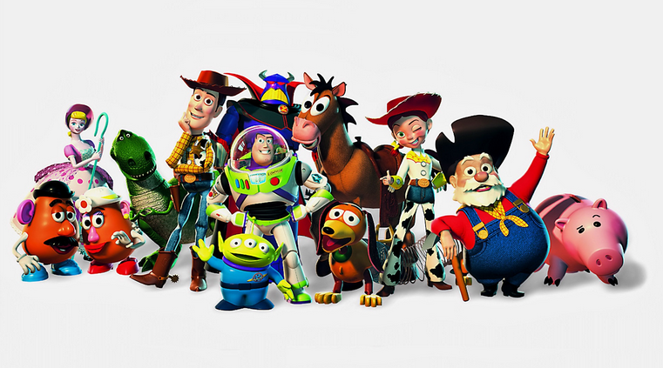
Carl Jung and Archetypes

Slide 2
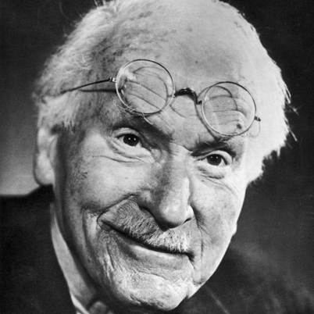
Carl Jung
Freud’s a dirtbag….
1875-1961
Freud’s BFF
Friendship ended over furious argument over the nature of the unconscious
Psychotic breakdown
Supported Nazis
Believed all humans share a vast collective unconscious, not just a personal unconscious.

Slide 3
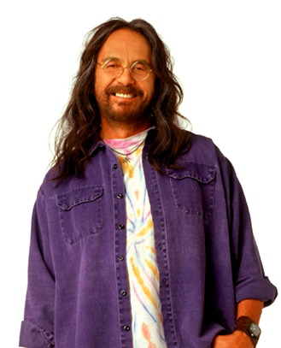
Collective Unconscious
Woah, man, that’s, like, totally far out.
All humans share universal memories, symbols, images, and themes
Called “archetypes”
Holds true across all peoples and cultures

Slide 4
Archetypes
A very typical example of a certain person or thing.
Can be found in fairy tales, legends, and popular stories.
A quintessential model of the…
Hero
Nurturing mother
Powerful father
Wicked witch
Etc.

Slide 5
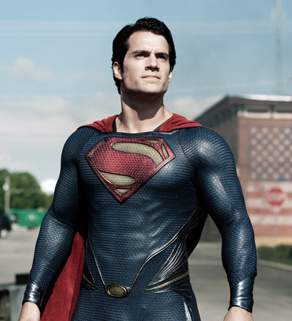
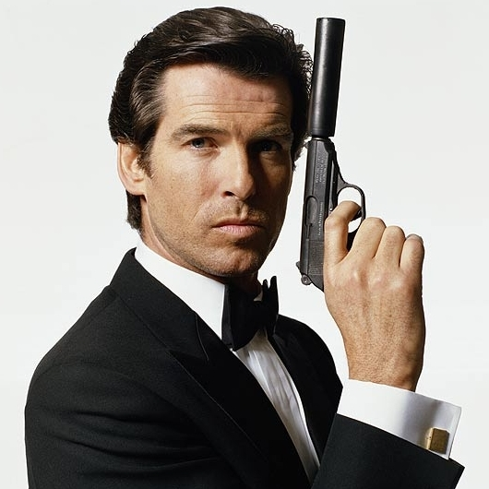
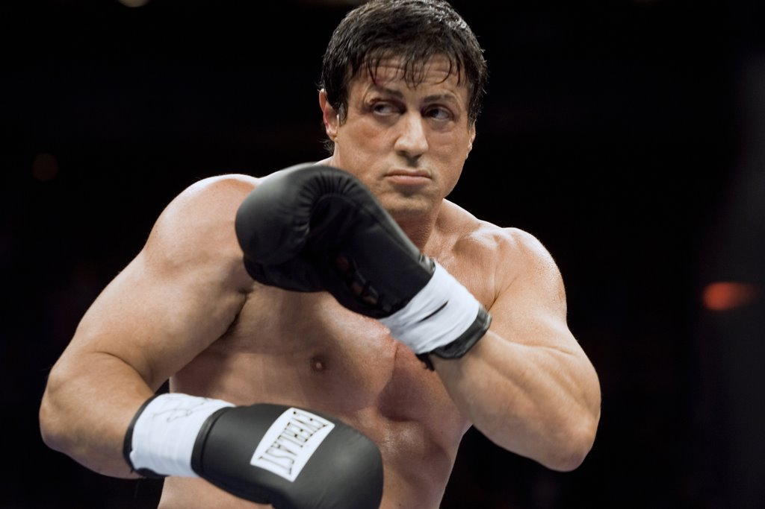
The Hero
Larger-than-life character that often goes on some kind of journey or quest.
Demonstrates the qualities and abilities valued by his culture.

Slide 6
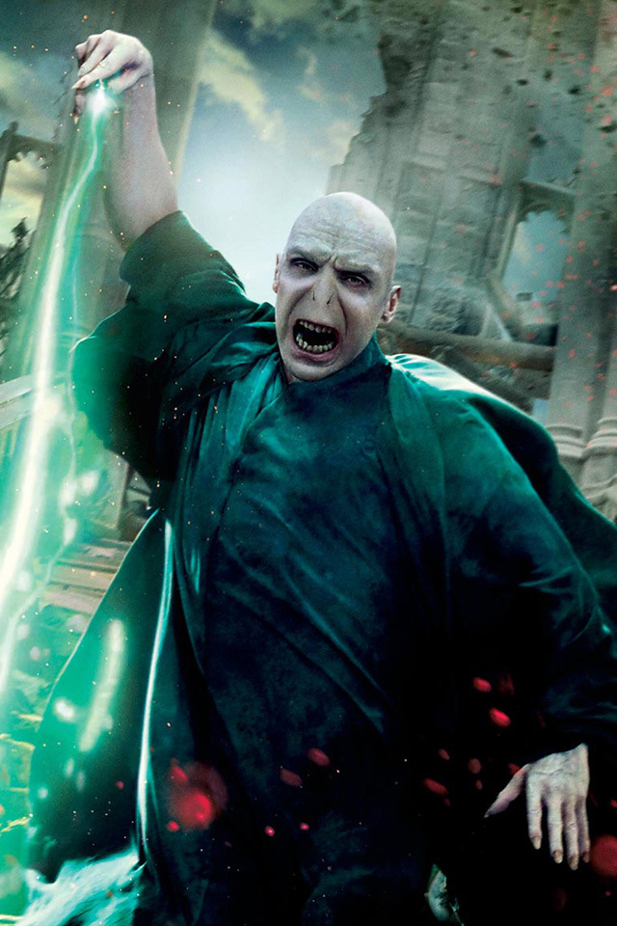
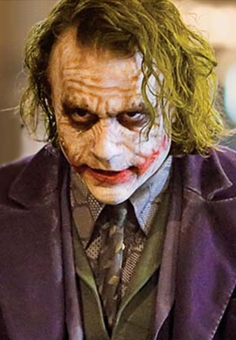
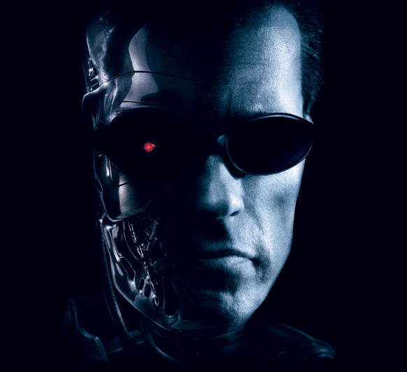
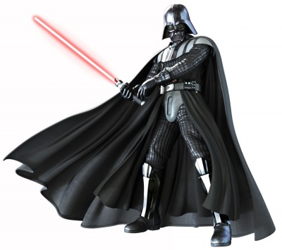
The Villain
The antagonist working in opposition to the hero

Slide 7
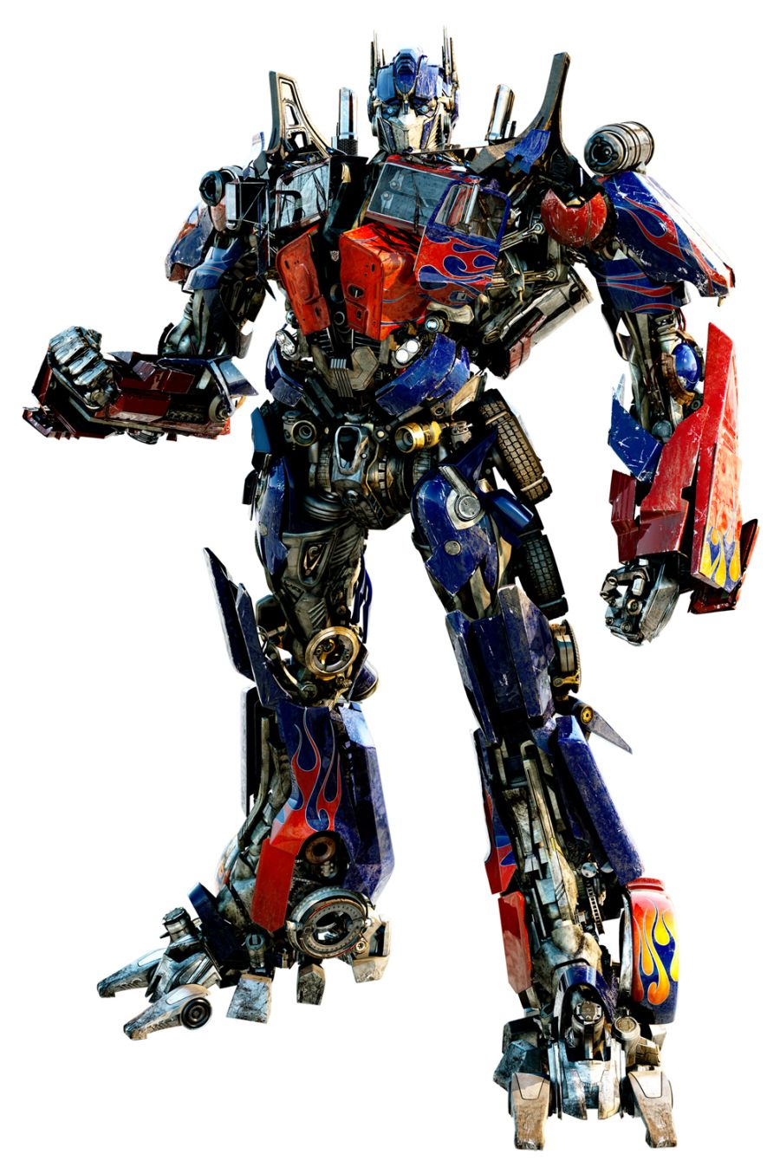
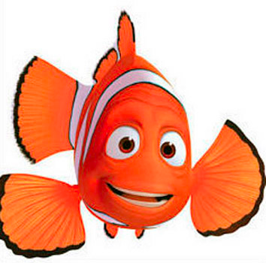
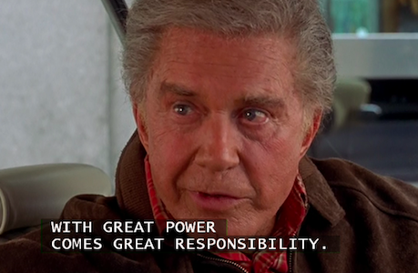
The Wise Father
The protector and leader

Slide 8
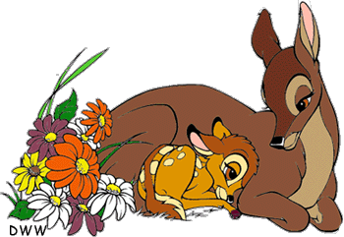
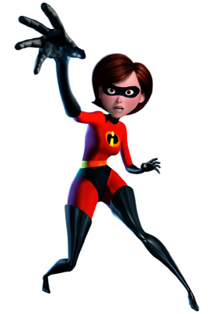
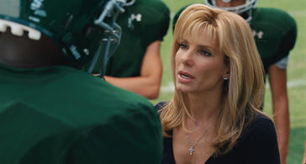
The Nurturing Mother
The protective nurturer and gentle provider

Slide 9
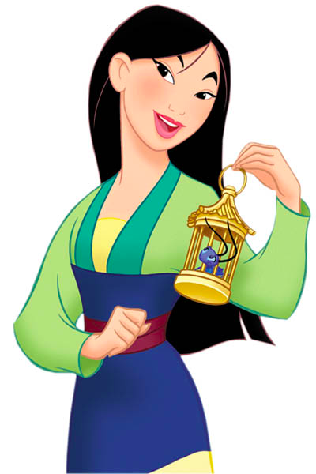
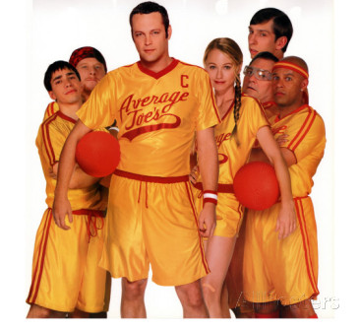
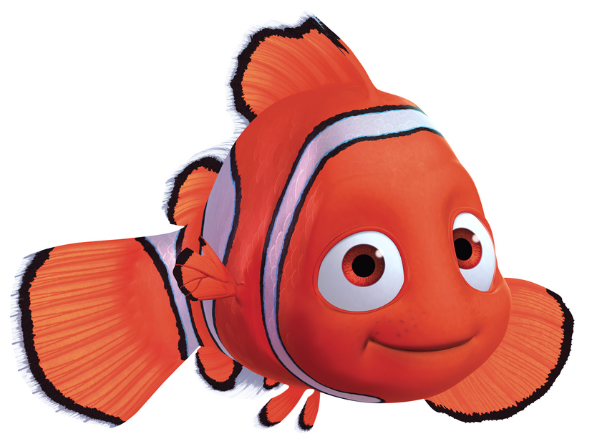
The Underdog
Characters who are always in the wrong place at the wrong time, but who usually win something of value in the end

Slide 10
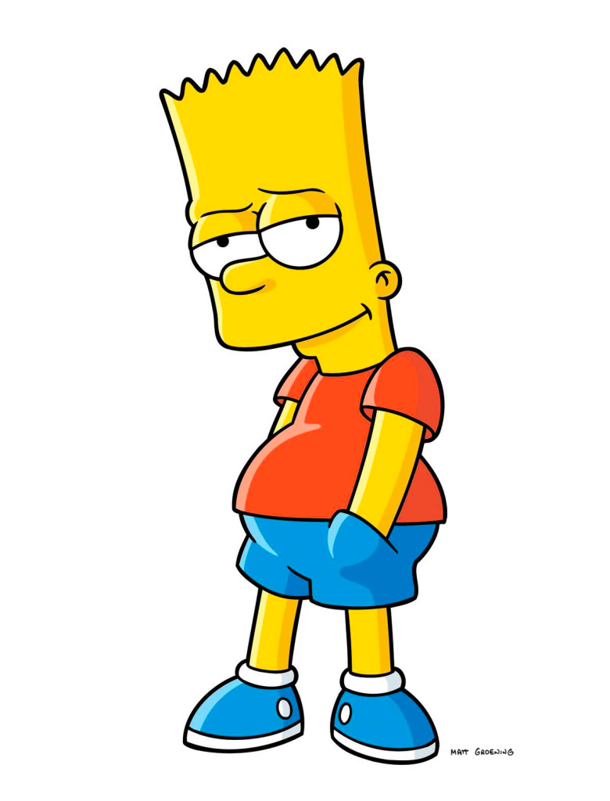
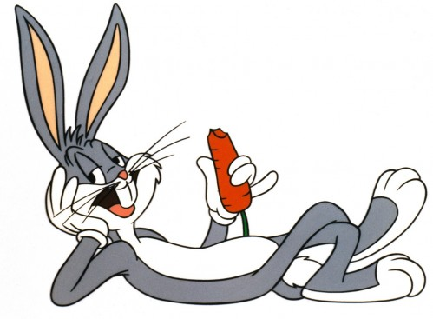
The Trickster
Characters who trick others to get them to do what she/he wants – they can be both virtuous and wicked.

Slide 11
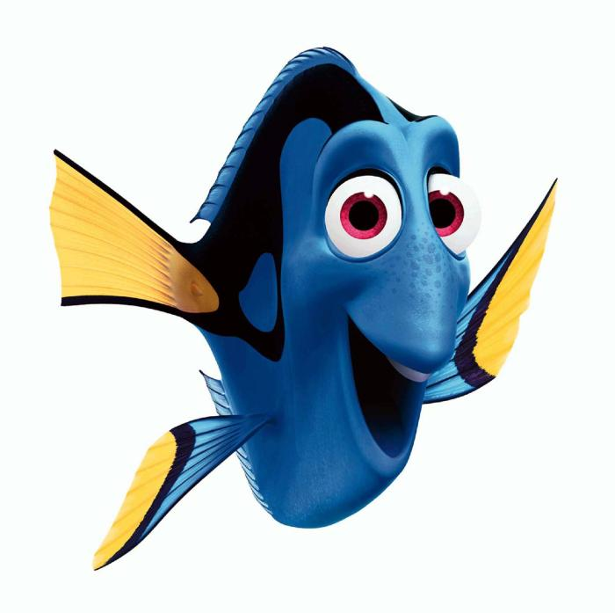
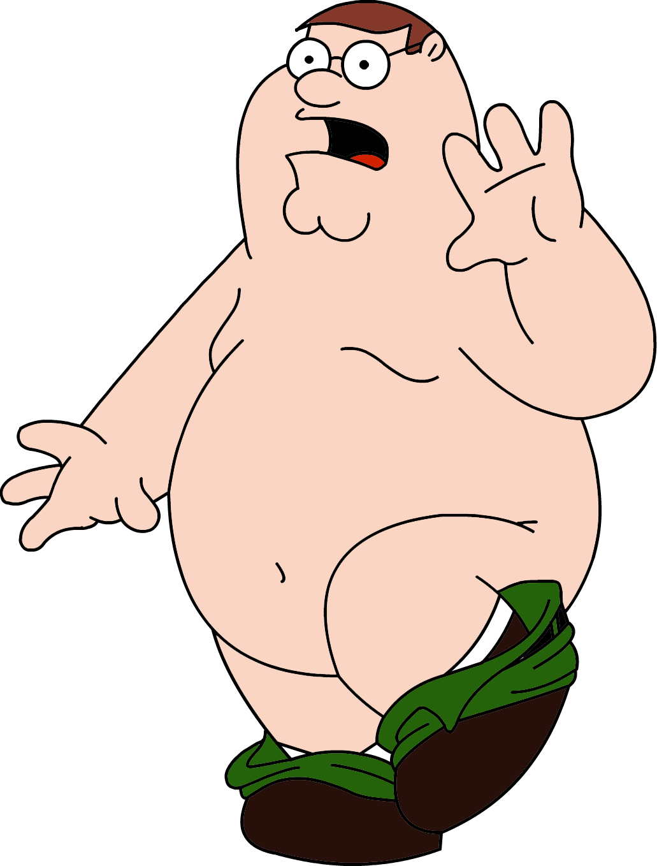
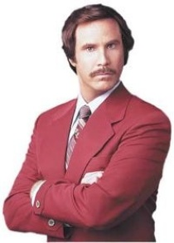
The Fool
Always optimistic things will turn out well. Has time for silly antics. Wears his/her heart on sleeve.

Slide 12
The Fatal Woman or Temptress
A woman who uses her power (intellect, magic, or most of all, beauty) to make men, especially the Hero, weak

Slide 13
Try it! Match the Toy Story characters below with their archetypes.

Slide 14
Maleness & Femaleness
Two of Jung’s most important archetypes
“Masculine” & “feminine” qualities exist in both sexes
Problems arise if a person tries to suppress his/her opposite archetype

Slide 15
Gender Stereotypes in Movies
Maleness:
Femaleness:

Slide 16
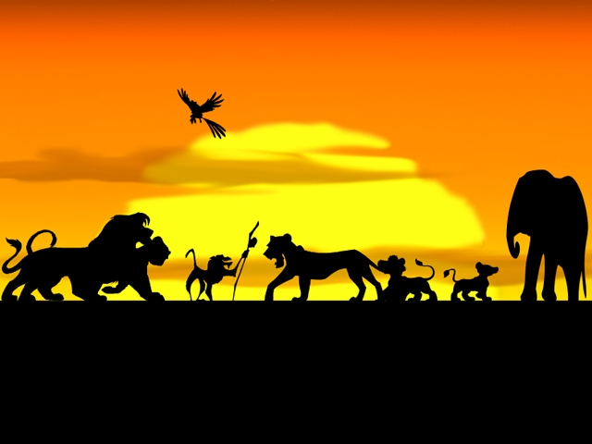
Movie Time!

