Slide 1
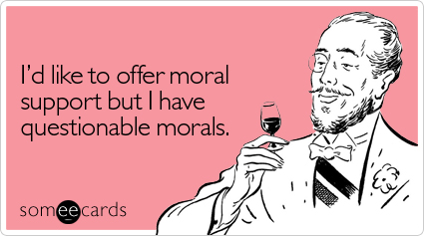
Learning to Be Good
Moral Development

Slide 2
Runaway Trolley!
A runaway trolley is coming down the track. It is headed towards five people who cannot get out of its way. A passerby realizes that he can save the five by throwing a switch and diverting the trolley down a siding, but he also realizes that if he does so, the trolley will kill a lone man standing on the siding.
http://tomkow.typepad.com/tomkowcom/trolley_problem/

Slide 3
Should you divert the trolley?

Slide 4
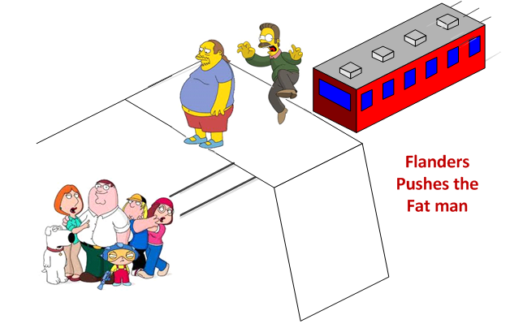
Runaway Trolley!
A runaway trolley is coming down the track. It is headed towards five people who cannot get out of its way. A passerby realizes that if he pushes a large man onto the tracks his bulk will stop the trolley before it hits the five, though the large man himself will be killed.
http://tomkow.typepad.com/tomkowcom/trolley_problem/

Slide 5
Should you divert the trolley?

Slide 6
Kohlberg’s Stage of Moral Development
Pre-Conventional Morality
Conventional Morality
Post-Conventional Morality

Slide 7
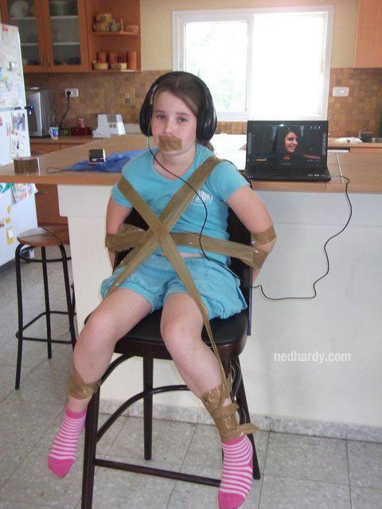
Pre-Conventional Morality
0-9 years old
See rules as fixed and absolute
Decision based on consequences
“Will I be punished?”
Actions based on rewards or punishments

Slide 8
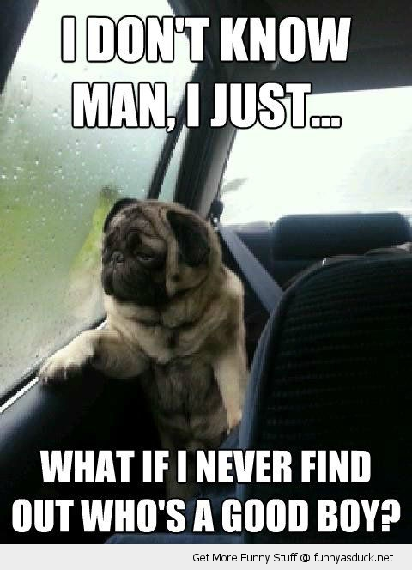
Conventional Morality
Adolescence to adulthood
“Good-boy, Good-girl” Stage
Emphasis on being “nice” and behaving in a “good” way
Decisions based on conformity to rules and laws
Based on caring for others
Act “good” because they demonstrate love, empathy, trust, and concern for others

Slide 9
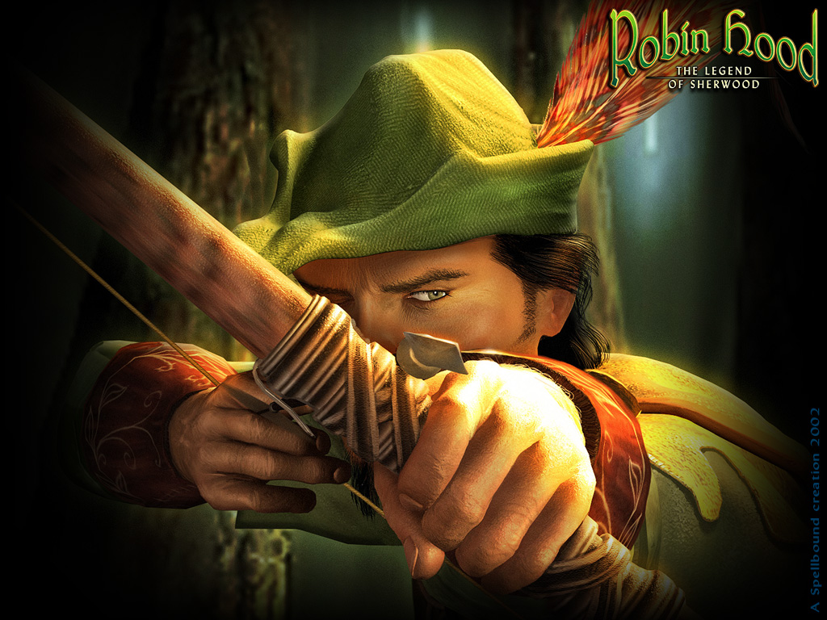
Post-Conventional Morality
Some adults
Decisions based on internalized principles of fairness, justice, truth
Even if they conflict with laws and rules
Martin Luther King, Mahatma Ghandi, Susan B. Anthony
Rules of law are important for maintaining a society, but members of the society should agree upon these standards.

Slide 10
But…
“We can reach high levels of moral reasoning, and still behave like scoundrels.”
--Thomas Lickona (1983)

