Slide 1
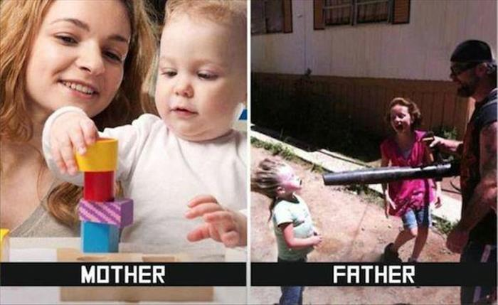
Parenting Styles
I promise to make this as quick as possible…

Slide 2
Authoritative
Encourage independence
Place limits, consequences, and expectations
Nurture, express warmth
Allow children to express opinions
Encourage child discussion of options (supportive)
Administer fair & consistent discipline

Slide 3
Authoritarian
Strict rules & Expectations
Very demanding, yet not responsive
Don’t express much warmth or nurturing
Utilize punishments with little/no explanation
Restrict choices & options of child

Slide 4
Permissive
Have few rules or standards of behavior
When there are rules, they are often very inconsistent
Are usually very nurturing and loving towards their kids
Often seem more like a friend, rather than a parent
May use bribery such as toys, gifts and food as a means to get child to behave

Slide 5
Uninvolved
Are emotionally distant from their children
Offer little or no supervision
Show little warmth, love, and affection towards their children
Have few or no expectations or demands for behavior
Don't attend school events and parent-teacher conferences
May intentionally avoid their children
Often too overwhelmed by their own problems to deal with children

Slide 6
