Slide 1
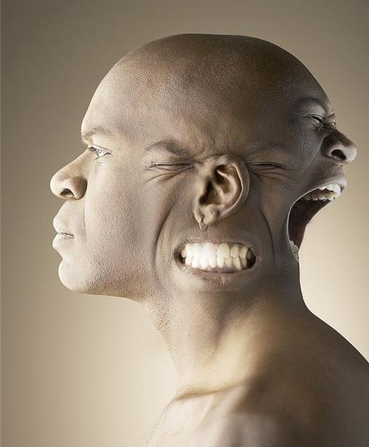
Personality

Slide 2
Personality
“Characteristic pattern of thinking, feeling, and acting”

Slide 3
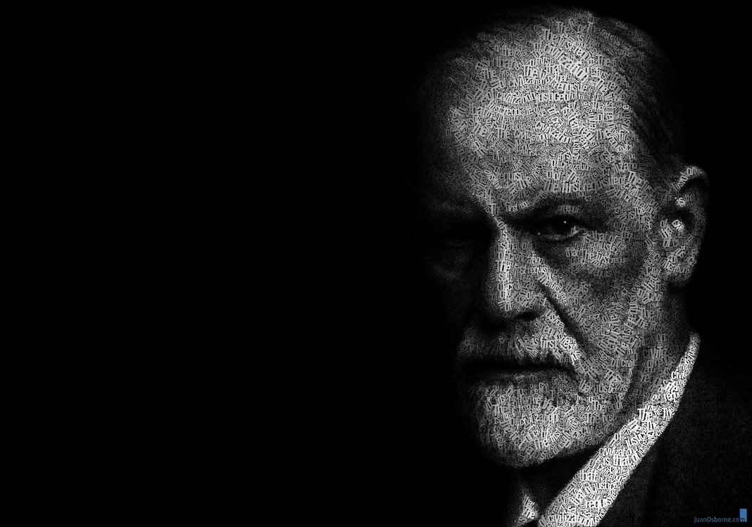
Psychodynamic Perspective
Unconscious: most of our behavior is determined by motives that we are unaware of.
Example: If your blonde father abused you, you may unknowingly harbor hatred for blondes

Slide 4
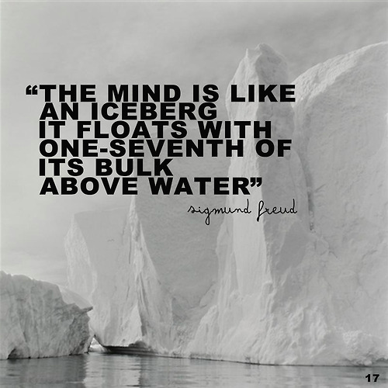

Slide 5
Psychodynamic Perspective
Conscious: things we are aware of
Preconscious: things we can be aware of if we thing of them
Unconscious: deep, hidden resevoir that holds our “true” self—all of our fears and desires.

Slide 6
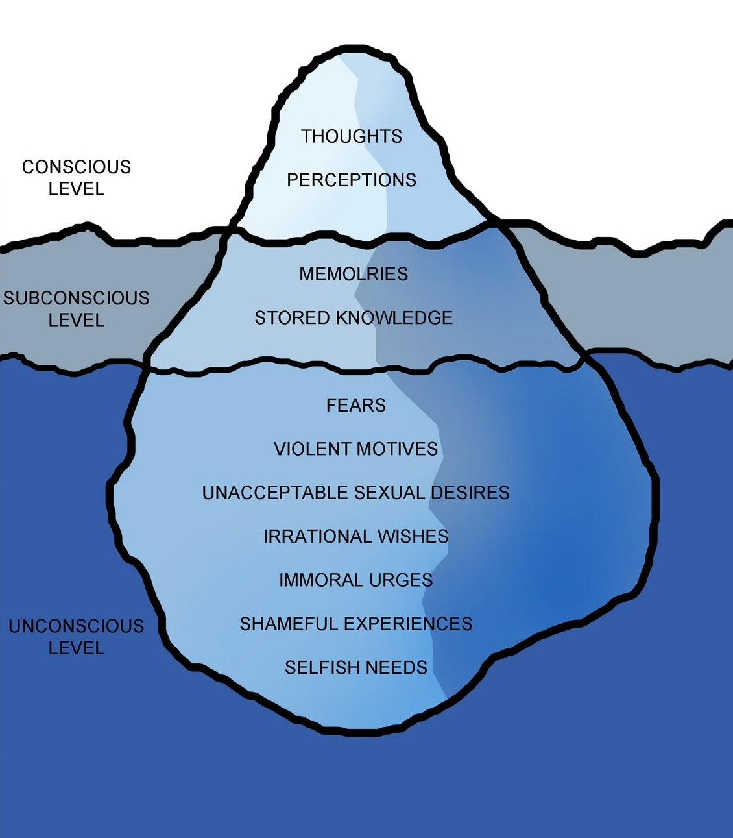

Slide 7
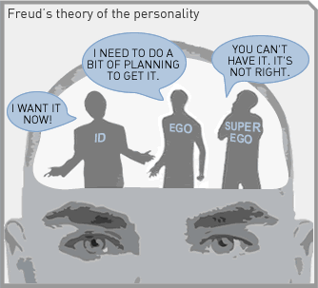
Freud’s Personality Structure
Id: energy Striving to satisfy basic drives
Ego: Seeks to gratify the id in realistic ways
Superego: voice of conscious that emphasizes how we ought to behave

Slide 8
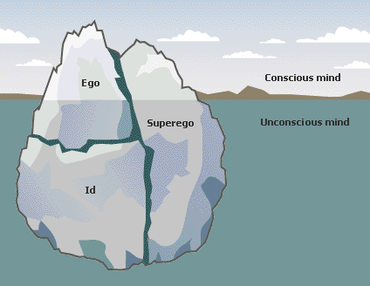
Id, Ego, Superego

Slide 9
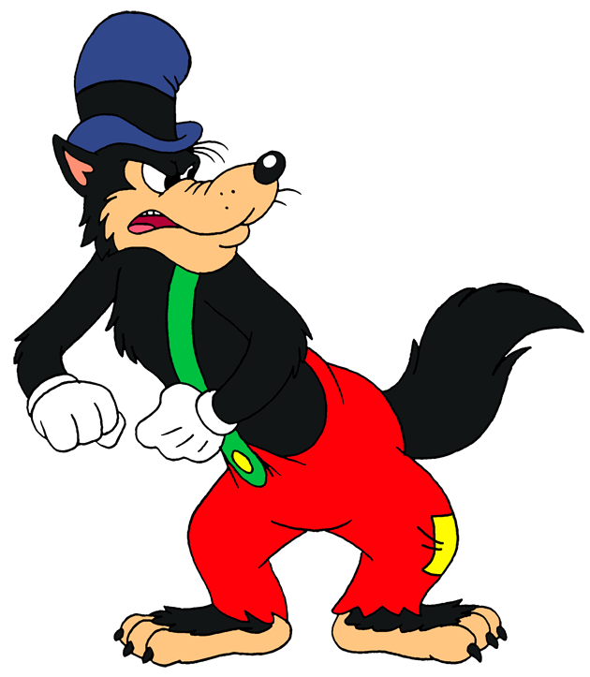
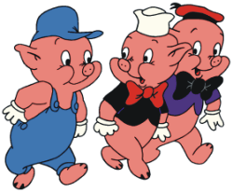
Who’s Afraid of the Big Bad Wolf?
http://www.youtube.com/watch?v=ShE27Hst_NM&feature=related

Slide 10
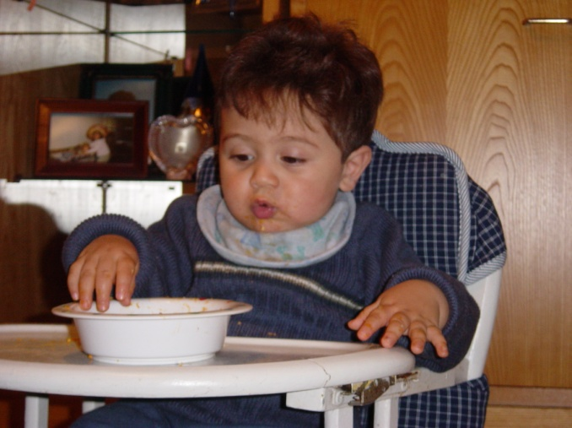
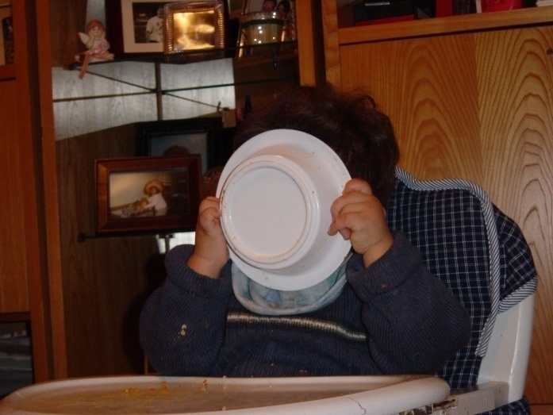
Id
Exists entirely in the unconscious (we are unaware of it)
Our hidden true animalistic wants and desires
Works on the Pleasure Principle
Avoid pain and obtain pleasure

Slide 11
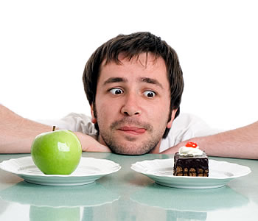
Superego
Develops last at about age 5
This is our conscience
How we differentiate between right and wrong
Your “inner voice”
Pride and satisfaction when you do good; guilt and shame when you break the rules

Slide 12
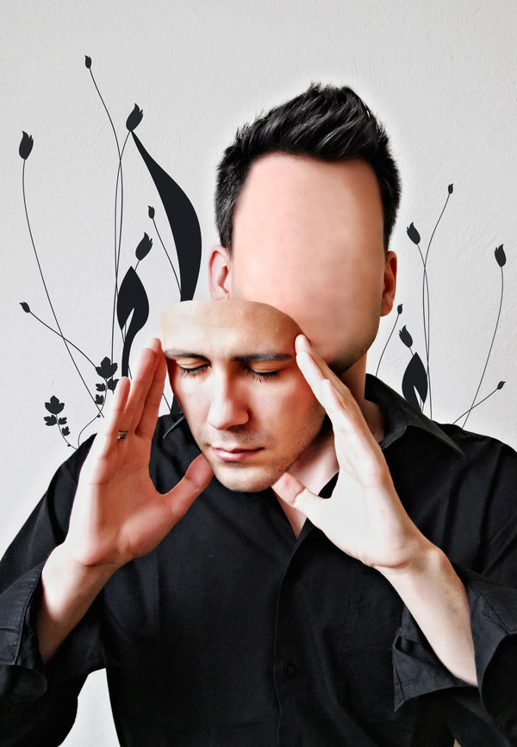
Ego
Develops after the id
Represents “reason and good sense”
Negotiates between the id and the environment
In both our conscious and unconscious minds
THIS is what everyone sees as our personality

Slide 13
“
The Ego is not who you really are. The ego is your self-image; it is your social mask; it is the role you are playing. Your social mask thrives on approval. It wants control, and it is sustained by power, because it lives in fear.
”
--Deepak Chopra

Slide 14
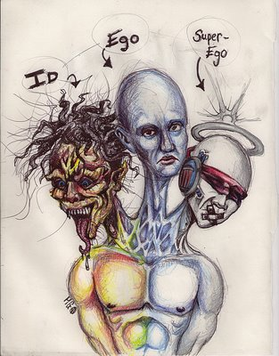

Slide 15
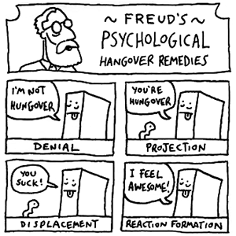
Defense Mechanisms
The ego must protect you from threatening thoughts in our unconscious
Enter “defense mechanisms”
Methods used to reduce or redirect anxiety by distorting reality
You are usually unaware they are occurring
http://www.youtube.com/watch?v=e-NP__ExSSE

Slide 16
Scenario!
Quarterback of the football team, Simon, is dating the head cheerleader, Paula.
Awe…

Slide 17
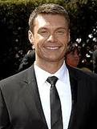
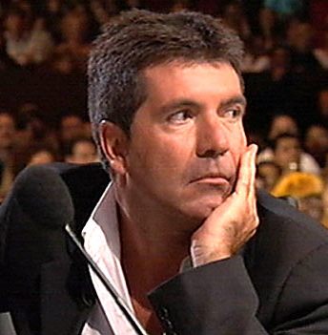
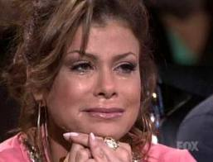
Scenario!
Paula dumps Simon and starts dating Ryan, from Chess Club.
Sup.
Simon
Paula
Ryan

Slide 18
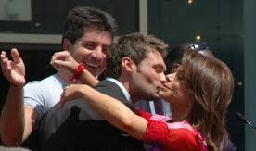
1.) Repression
Pushing thoughts into our unconscious.
When asked about Paula, Simon may say, “Who? I’ve not thought about her for a while.”
Why don’t we remember our Oedipus and Electra complexes?

Slide 19
2.) Projection
Disguises threatening impulses by attributing them to others. Thus, “She doesn’t trust me” may really be “I don’t trust myself”
Simon insists that Paula doesn’t trust him and that is the problem but Simon really doesn’t trust himself.

Slide 20
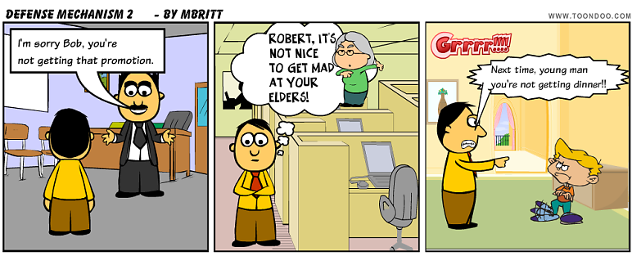
3.) Displacement
Redirecting one’s feelings toward another person or object.
Often displaced on less threatening things.
Children who fear expressing anger against their parents may displace it by kicking the family pet.
Student upset over a test score may snap on a friend.

Slide 21
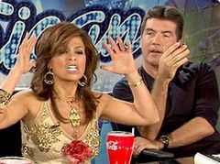
4.) Reaction Formation
Cootie stage in Freud’s Latent Development
Process of pushing away threatening impulses by making unacceptable impulses look like their opposites.
“I hate Paula” but really means “I love Paula”

Slide 22
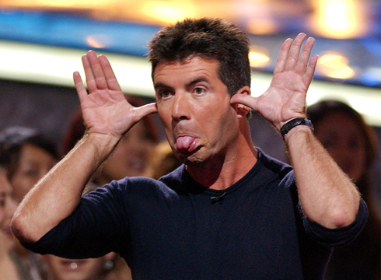
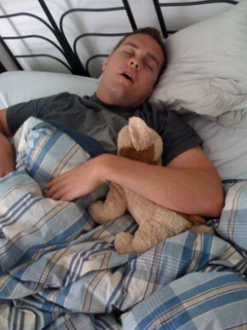
5.) Regression
Returning to an earlier, comforting form of behavior
Simon throws a temper tantrum when Paula breaks up with him.
Brandon begins to sleep with a stuffed animal from his childhood to cope with his mother passing.
← That’s Brandon.

Slide 23
Practice!
Have Freudian concepts registered in your unconscious? Which Freudian defense mechanisms do the following suggest?

Slide 24
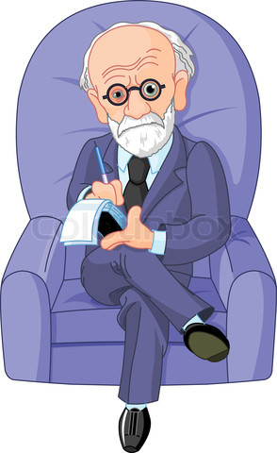
A 6-year-old boy who moves to a new city starts sucking his thumb.
An alcoholic storms out of his intervention because “he doesn’t have a damn drinking problem!”
A man who is angry at his boss shouts at his kids for making noise.
A woman whose father was cruel to
her when she was little insists over
and over that she loves him dearly.
A racist justifies segregation by saying
that black men are only interested
in sex with white women.

Slide 25
How’d You Do??
Regression
Denial
Displacement
Reaction Formation
Projection

Slide 26
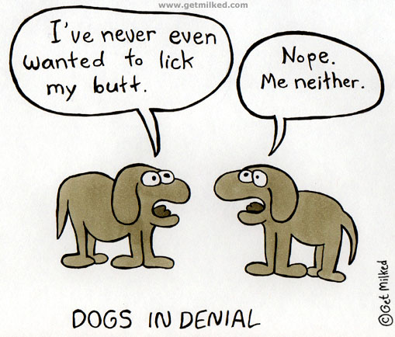
6.) Denial
Not accepting the ego-threatening truth
Simon may act like he is still together with Paula. He may hang out by her locker and plan dates with her.

Slide 27
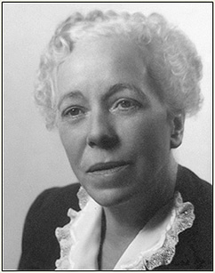
Critics of Freud…
Carl Jung believed we also have a collective unconscious, a reservoir of images derived from our species universal experiences. This collective unconscious explains why for many people spiritual concerns are deeply rooted and why people in different cultures share certain myths and images, such as the mother as a symbol of nurturance.

Slide 28
Psychoanalysis Today
Couch sitting
Transference is likely to happy
The idea is to delve into your unconscious
Pull out Manifest Content
Then talk about the Latent Content

Slide 29
Getting into the Unconscious
Hypnosis
Dream Interpretation
Free Association
“Talk to yourself, I’ll interpret the conversation”
Projective Tests
TAT and Inkblot tests

Slide 30
What are projective tests, you ask??
Aim to provide “psychological x-ray” by asking takers to describe or tell a story
Thematic Apperception Test → people view pictures then make up stories about them.
Answers can give insight into their latent content

Slide 31
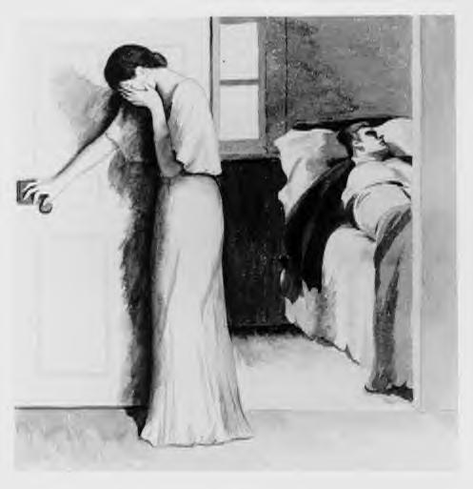

Slide 32
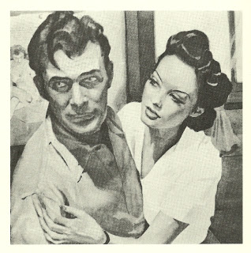

Slide 33
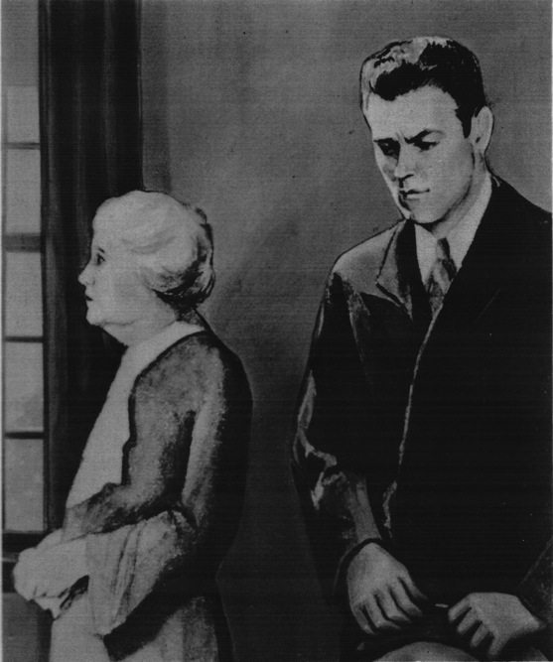

Slide 34
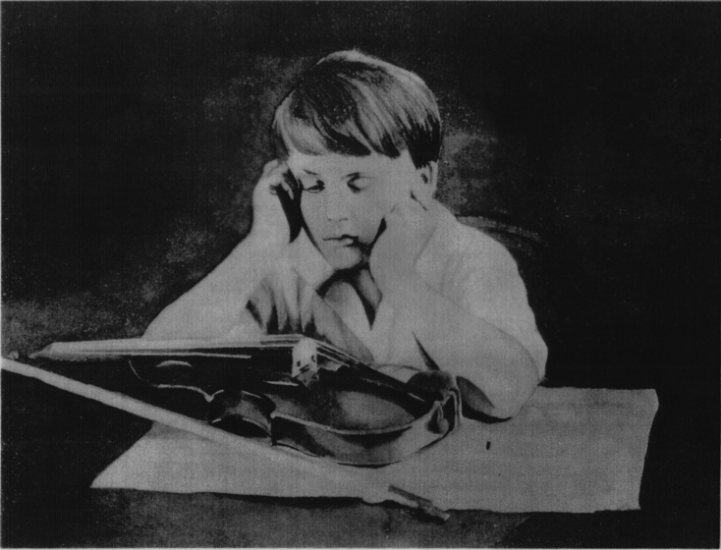

Slide 35
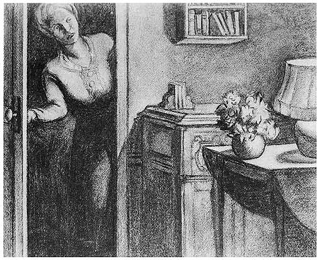

Slide 36
What are projective tests, you ask??
Another method of psychoanalysis is the Roschach Inkblot Test
Most widely used projective test
A set of ten inkblots designed to identify people’s feelings when they are asked to interpret what they see in the inkblots

Slide 38
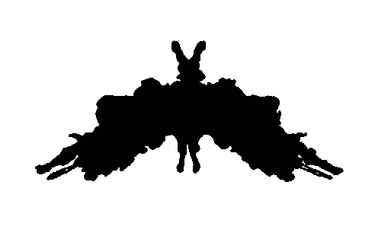

Slide 40
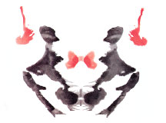

Slide 41
“Trait Perspective”
No hidden personality dynamics, just basic personality dimensions!
Traits—people’s characteristic behaviors and conscious motives
How do we describe and classify different personalities?
Type A vs. Type B
Depressed vs. Cheerful

Slide 42
Trait Theories of Personality
Believe we can describe people’s personality by specifying their main characteristics (traits)
Traits like honesty, laziness, ambition, independence are thought to be stable over your lifetime.

Slide 43
Are there “Basic” Traits?
Combination of 2 or 3 genetically determined dimensions
Extraversions vs. Introversion
Emotional Stability vs. Emotional Instability
Expanded set of factors
“The Big Five”

Slide 44
“The Big Five”
Calm/Anxious
Secure/Insecure
Emotional Stability
Sociable/Retiring
Fun Loving/Sober
Extraversion
Imaginative/Practical
Independent/Conforming
Openness
Soft-Hearted/Ruthless
Trusting/Suspicious
Agreeableness
Organized/Disorganized
Careful/Careless
Conscientiousness

Slide 45
Rate Your Traits!
For each item, write a number from 1 to 7 indicating the extent to which you see that trait as being characteristic of you, where…
1 = “I disagree strongly that this trait describes me.”
to
7 = “I agree strongly that this trait describes me.”
Test designed by Samuel D. Gosling

Slide 46
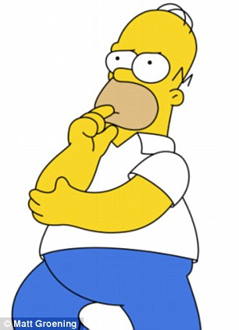
Extroverted, enthusiastic
Critical, argumentative
Dependable, self-disciplined
Anxious, easily upset
Open to new experiences, complex
Reserved, quiet
Sympathetic, warm
Disorganized, careless
Calm, emotionally stable
Conventional, uncreative

Slide 47
Score Yourself!
Extroversion: High on Q1, Low on Q6
Emotional instability: High on Q4, Low on Q9
Nice: High on Q7, Low on Q2
Careful: High on Q3, Low on Q8
Openness: High on Q5, Low on Q10

Slide 48
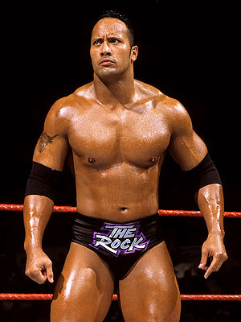
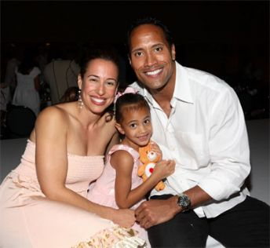
Trait Theory Criticism
Do NOT take into account the importance of the situation.
People act differently when placed in different situations!
Dwayne Johnson at
work
Dwayne Johnson
at home →

Slide 49
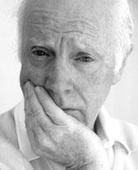
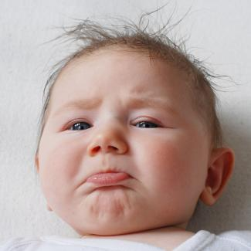
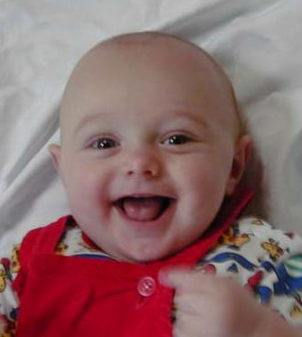
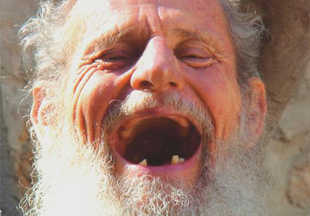
Biological Perspective
What percentage of personality is inherited?
“Heritability”
We are not sure BUT temperaments do seem to be stable from infants to old age.

Slide 50
Practice!
I hope you have a few quiz-taking genes.

Slide 51
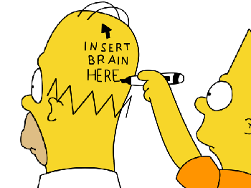
Practice!
What three broad lines of research support the hypothesis that personality differences are due in part to genetic differences?
In behavioral-genetic studies, the heritability of personality traits, including the Big Five, is typically about…
0.50
0.90
0.10 to 0.20
0

Slide 52
Practice!
A newspaper headlines announces: “Couch Potatoes Born, Not Made: Kids’ TV Habits May Be Hereditary.” Why is this headline misleading? What other explanations of the finding are possible? What aspects of TV watching could have a hereditary component?

Slide 53
How’d You Do??
Research on animal personalities, human temperaments, and the heritability of traits
A = 0.50
The headline implies there is a “TV-watching gene,” but there obviously isn’t such a gene. The writer fails to consider other explanations. For example, perhaps some temperaments dispose people to be passive, and this disposition leads to a tendency to watch a lot of TV

Slide 54
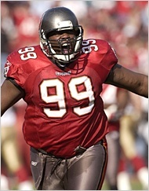
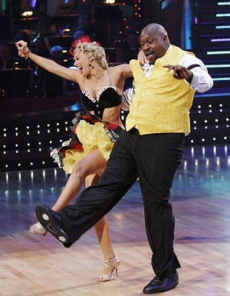
Behavioral Perspective
The way most people think of personality is meaningless
Personality changes according to environment
Awards and punishment
If you change the environment, you can change the personality

Slide 55
___ Perspective

Slide 56
Practice!
I want to nurture your appreciation of quizzes because it’s in our nature to give them to you.

Slide 57
Practice!
What three lines of evidence have disputed the belief that parents are the major influence on their children’s personalities?
Which contributes most to the variation among siblings in their personality traits:
The family environment that all of them share
The way their parents treat them
The unique experiences they have that
are not shared with families

Slide 58
How’d You Do??
The shared family environment has little, if any influence. Few parents have a consistent child-rearing style. Even when parents try to be consistent in the way they treat their children, there may be little relation between what they do and how the children turn out.
C = The unique experiences they have that are not shared with families

Slide 59
Sociocultural Perspective
Behavior learned through
conditioning & observation
What we think about our situation
affects our behavior
Interaction of
Environment & Intellect

Slide 60
Albert Bandura
Modeling: Bandura’s term for learning by imitating others.
Discussion: List ways that freshmen model themselves after seniors. For example Imagine freshman year. What kinds of things did seniors do that were cool? Did they hold their books or walk in a particular way. Hang out in certain places or sit in a place.

Slide 61
Practice!
At the moment, you live in a culture that values the importance of quizzes.

Slide 62
Practice!
Cultures whose members regard the “self” as a collection of stable personality traits are…
Individualist
Collectivist
A Mexican visitor to England wonders why everyone he meets seems to stand too far away from him in conversation. When he moves closer, they move away. Mexico and England have different rules of ________.

Slide 63
Practice!
Why, according to one theory, do men in the American South and West respond more aggressively to perceived insults than other American men do?

Slide 64
How’d You Do??
Individualist
Conversational distance
These men come from regions in which economies based on herding gave rise to “cultures of honor,” requiring males to be vigilant and aggressive toward potential threats.

Slide 65
Humanistic Perspective
Abraham Maslow’s
Self-Actualizing
Person
Carl Rogers’s
Person-Centered
Perspective
Humanists view the person as “healthy” rather than “sick.”
The individual is greater than the sum of his test scores.

Slide 66
Practice!
Exercise free will, as a humanist would advise you to, by choosing to take the following quiz.

Slide 67
Practice!
According to Carl Rogers, a man who loves his wife only when she is looking her best is giving her positive regard that is…
Conditional
Unconditional
The humanist who described the importance of having peak experiences was…
Abraham Maslow
Rollo May
Carl Rogers

Slide 68
Practice!
A humanist and a Freudian psychoanalyst are arguing about human nature. What underlying assumptions about psychology and human potential are they likely to bring to their discussion? How can they resolve their differences?

Slide 69
How’d You Do??
A = Conditional
A = Abraham Maslow
Freudian assumes human nature is selfish and destructive; Humanist assumes that human nature is loving and life-affirming. Can resolve debate by recognizing human beings have both capacities, and that situation and culture determine which capacity is expressed at a given time.

Slide 70
Humanistic Perspective

