Slide 2
Psychological Perspectives

Slide 3
Bell Ringer
Take a piece of blank paper
Divide it into SIX squares
Write the name of one of the perspectives in each square
Create a symbol to represent that perspective in the box

Slide 4
Psychology Today
Psychology
Biological Perspective
Learning Perspective
Sociocultural Perspective
Psychodynamic Perspective
Cognitive Perspective
Humanist Perspective

Slide 5
Concept Attainment

Slide 6
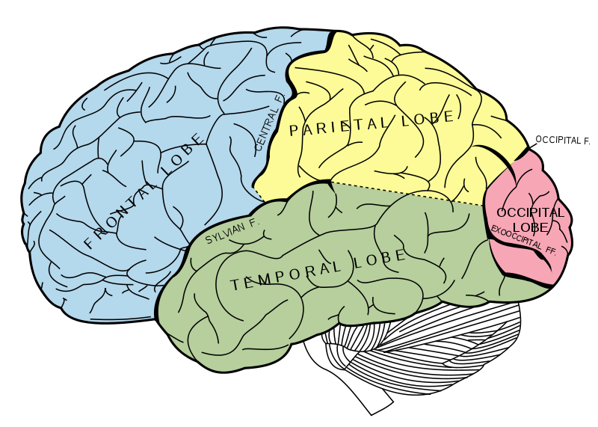

Slide 7
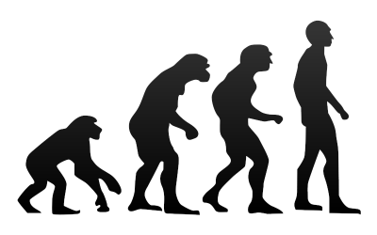

Slide 8
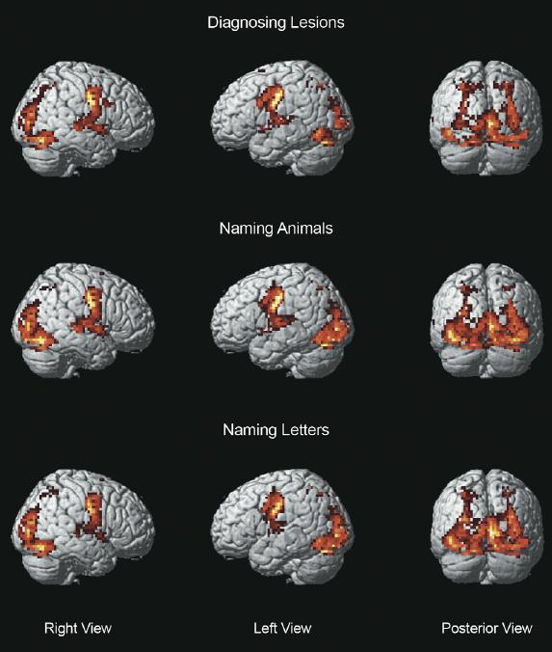

Slide 9
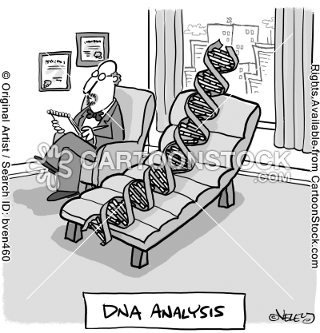

Slide 10
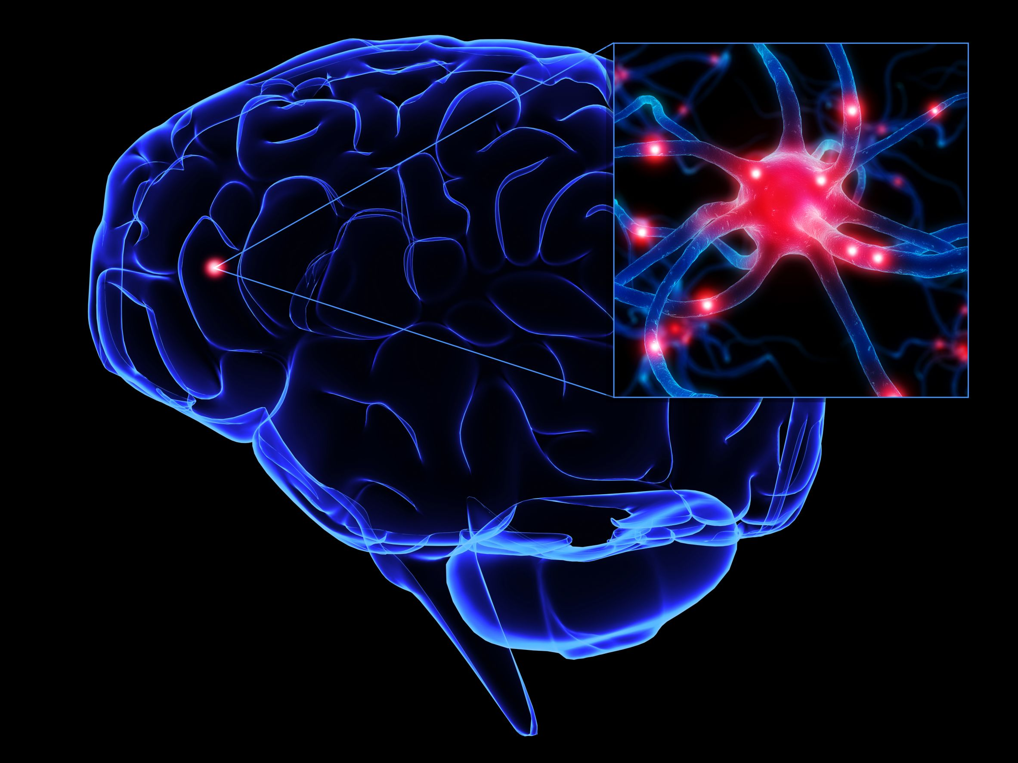

Slide 11
1.) Biological Perspective
Focuses on how chemical activity in the brain and body interacts with the external environment to affect behavior, feelings, and thought.
Terms you’ll hear: neuroscience, traits, brain, nervous system, genes, hormones, electrodes, neurons, etc.
Example 1: Is personality already predetermined at birth?
Example 2: How is blood chemistry linked with moods and motives?

Slide 12
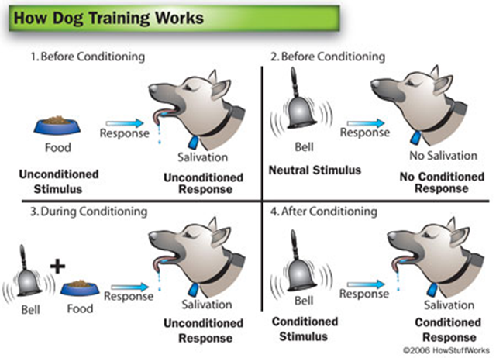

Slide 13
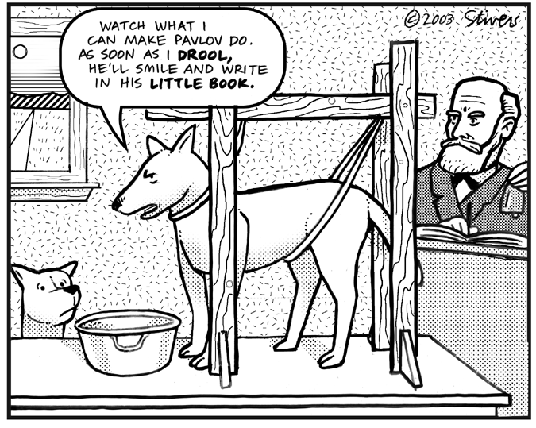

Slide 14
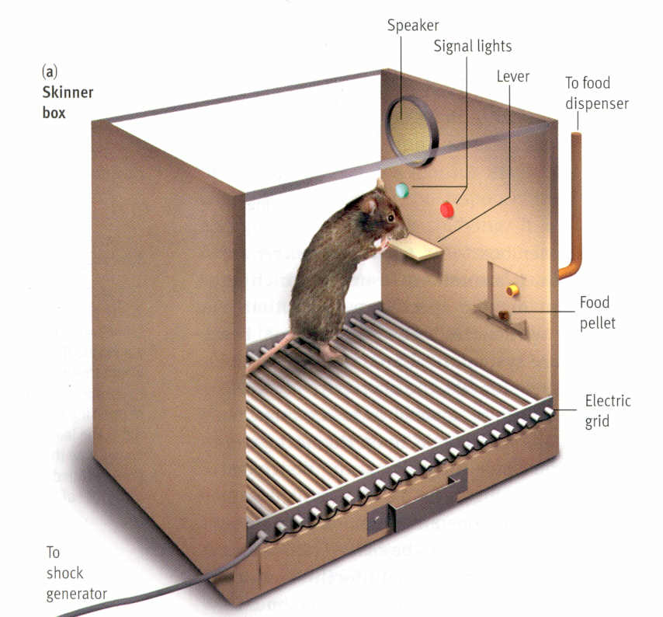
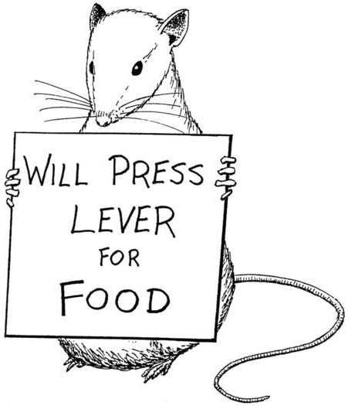

Slide 15
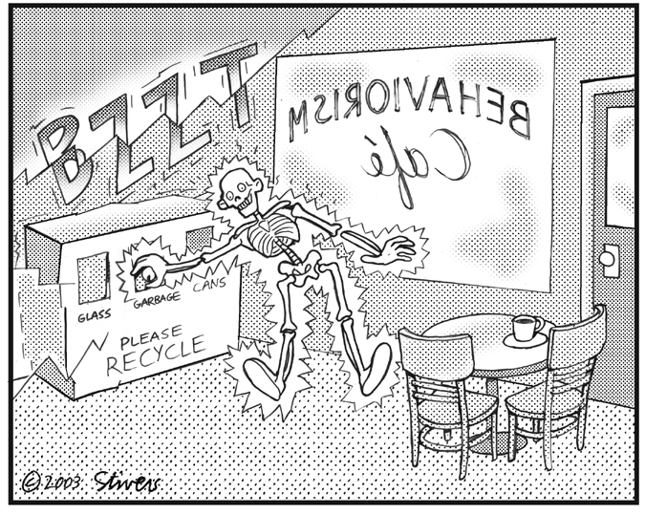

Slide 17
2.) Learning Perspective
Emphasizes how behavior is acquired or modified by environmental consequences (e.g. rewards and punishments)
Terms you’ll hear: positive reinforcement, negative reinforcement, stimulus, observation, reward, punishment, response, etc.
Example 1: What is the most effective way to alter our behavior to stop smoking?
Example 2: How can I train my dog?
http://www.youtube.com/watch?v=P4Rb9n_sQDg&feature=related

