Slide 2
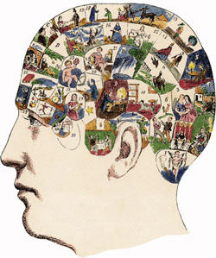

Slide 3
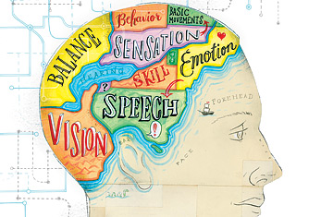

Slide 4
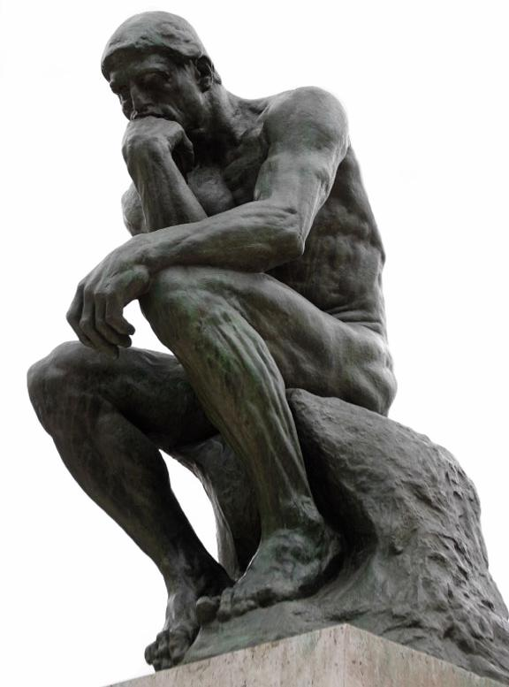

Slide 5
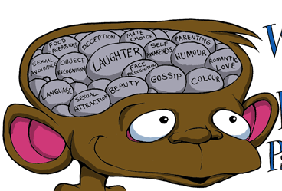

Slide 6
3.) Cognitive Perspective
Emphasizes mental processes in reasoning, memory, perception, language, problem solving, and beliefs.
Terms you’ll hear: reason, remember, think, sense, perceive, language, etc.
Example 1: Is your boyfriend dumping you traumatic or do you just think it is, therefore you are depressed?
Example 2: Children do not think like adults. Why?

Slide 10
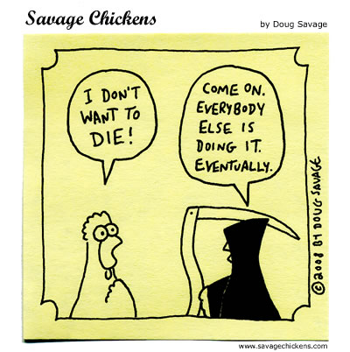

Slide 12
4.) Sociocultural Perspective
Focuses on the influence of social and cultural forces on behavior.
Terms you’ll hear: culture, religion, tradition, ethnicity, birthplace, family, peer pressure, groupthink, etc.
Example 1: How are we, as members of different races and nationalities, alike as members of one human family?
Example 2: Why do people sometimes act differently in groups than when alone?

