Slide 2
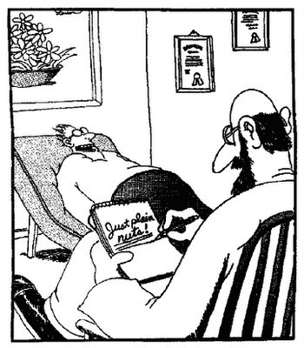

Slide 3
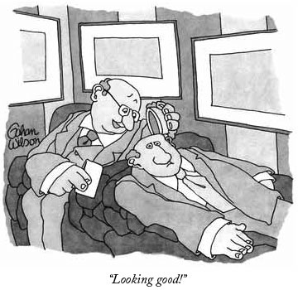

Slide 5
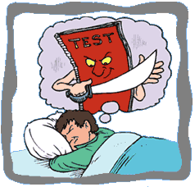

Slide 7
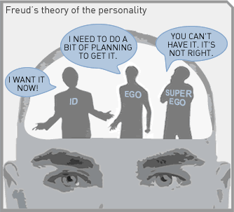

Slide 8
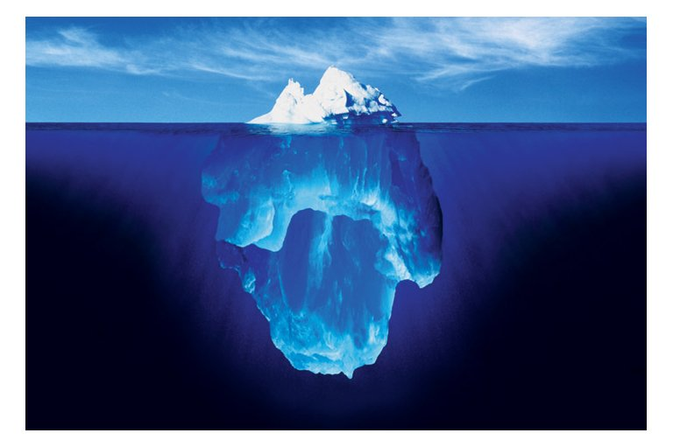

Slide 9
5.) Psychodynamic Perspective
Asserts that people’s thoughts and behaviors are motivated by powerful, unconscious drives and inner-conflicts.
Terms you’ll hear: Sigmund Freud, unconscious, “Freudian slip,” “Oedipus Complex,” sexuality, fears, desires, free association
Example 1: Do we unconsciously sexually desire our parent of the opposite sex?
Example 2: Does being abused as a child unconsciously influence future parenting ability?

Slide 10
5.) Psychodynamic Perspective
Also called “psychoanalytic”
Unconscious motives are motives that you are not aware of. For example, if someone with brown hair rejects you, then you might not talk to people with that hair color.
Conscious motives are motives you are aware of.
Freud use a technique called “free association.” He would say a word and you would say the first word that popped in your head and he would then analyze what is going on in your unconscious.

Slide 11
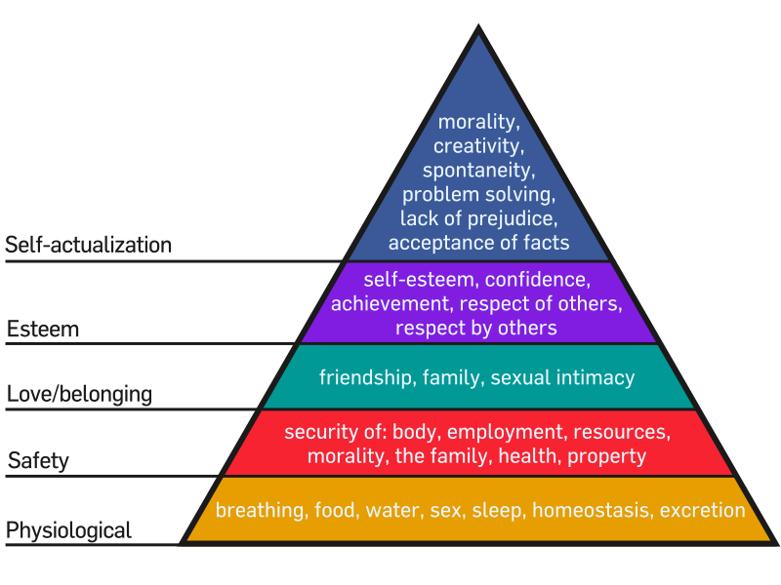
Maslow’s Hierarchy of Needs

Slide 15
6. Humanist Perspective
Centers on the conscious mind, free will, human dignity, and the capacity for self-actualization (striving to reach one’s potential)
Terms you’ll hear: free will, potential, self-actualization, fulfillment, goals, “feel good” approach, etc.
Example 1: How can we help the individual meet his/her fullest potential?
Example 2: How did your career goals influence your decision of where to attend college?

Slide 16
Different Approaches to Depression
 | Reasons for Depression | Ways to Help the Depression
Biological Perspective
Learning Perspective
Cognitive Perspective
Sociocultural Perspective
Psychodynamic Perspective
Humanist Perspective

