Slide 1
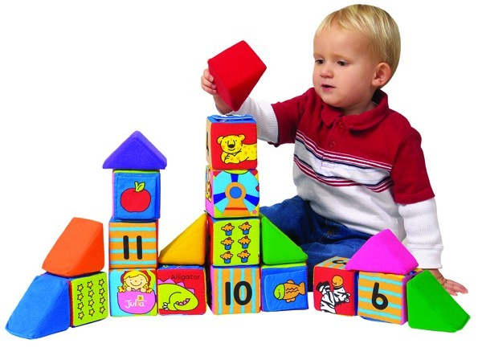
Piaget’s Stages of Cognitive Development

Slide 2
Assimilation vs. Accommodation
Children must make constant mental adaptations to new observations and experiences
Sometimes they assimilate info into their existing mental categories.
German shepherd & terrier both fit category of dogs
At other times, children must change their mental categories to accommodate new experiences.
Cat does belong to category of dogs
New category is required, one for cats

Slide 5
Four Stages of Cognitive Development
Stage | Age
Sensorimotor | 0 - 2
Preoperational | 2 - 7
Concrete Operational | 7 - 12
Formal Operational | 12 - Adulthood

Slide 6
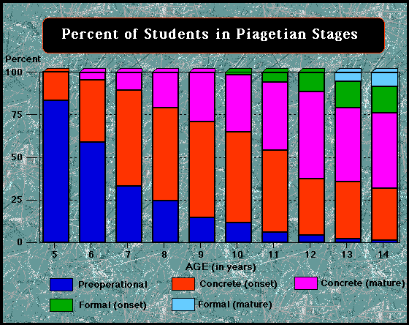
Can You Think Abstractly?

Slide 7
1.) Sensorimotor Stage
Age 0 to 2
Infant learns through looking, touching, hearing, sucking, etc.
Infant learns specific movements = specific results
Letting go of a stuffed bear will cause it to drop out of reach
Major Accomplishment: Object permanence

Slide 8
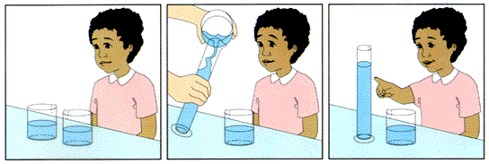
2.) Preoperational Stage
Age 2 to 7
Piaget described stage in terms of what children CAN’T do.
Reversibility, Conservation
Piaget preoperational children were egocentric
Can’t take another person’s point of view (theory of mind)
Egocentrism theory later discredited

Slide 9
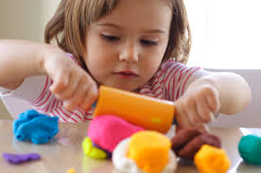
3.) Concrete Operational Stage
Age 7 to 12
Overcome egocentrism
Can take another person’s point of view
Newfound abilities tied to information that is concrete
Things that have happened to them or have meaning to them
Can’t comprehend abstract ideas
“Patriotism,” “Capitalism,” “Future education”
Do, however, understand reversibility, conservation, and cause-and-effect

Slide 10
4.) Formal Operational Stage
Age 12 to Adulthood
Capable of abstract reasoning
Can now reason about situations they have not experienced firsthand
Can think about future possibilities
Can compare and classify ideas

Slide 11
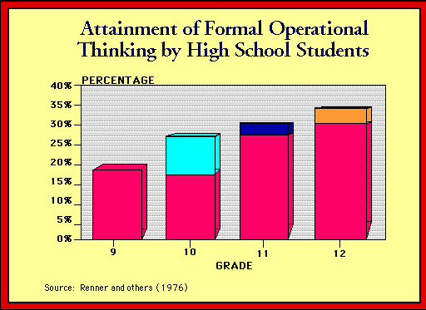
Can You Think Abstractly?

Slide 12
Practice!
Please actively interpret the following quiz.

Slide 13
Understanding that two rows of six pennies are equal in number, even if one row is spread out and the other is stacked up, is an example of ______________.
Understanding that a toy exists even after Mom puts it in her purse is an example of ___________, which develops during the ___________ stage.
A 5-year-old who tells his dad that “Sally said she saw a bunny but she was lying” has developed a ___________.

Slide 14
How’d You Do??
Conservation
Object permanence; sensorimotor
Theory of mind

