Slide 1
Developmental Psychology

Slide 2
From Conception Through Year 1

Slide 3
3 Main Debates
Nature vs. Nurture
Continuity vs. Discontinuity
Stability vs. Change

Slide 4
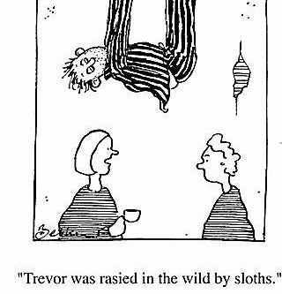
Nature vs. Nurture
How do genetic inheritance (nature) and experience (nurture) influence our development?

Slide 5
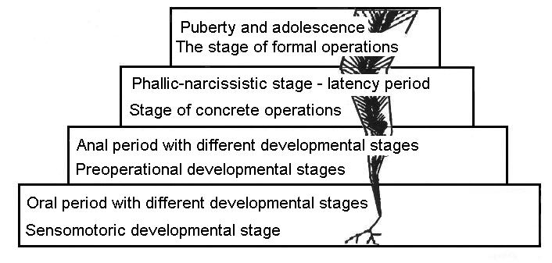
Continuity vs. Discontinuity
Is development a gradual, continuous process, (like riding an escalator) or does it proceed through the sequence of separate states (like climbing rungs on a ladder)?
OR

Slide 6
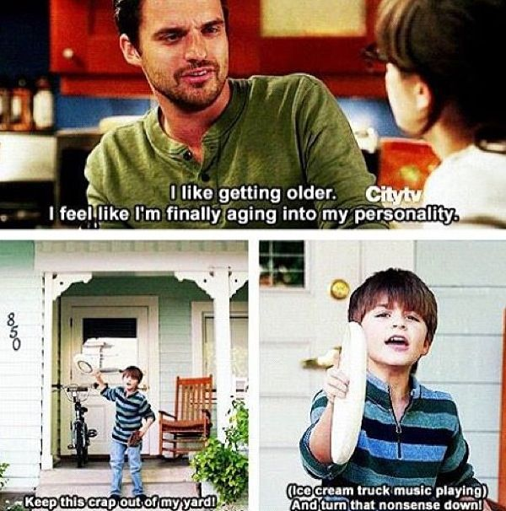
Stability vs. Change
Do our early personality traits persist through life, or do we become different persons as we age?

Slide 7
Research Methods
Cross-Sectional Studies
Participants of different ages studied at the same time
Longitudinal Studies
One group of people studied over a long period of time

Slide 8
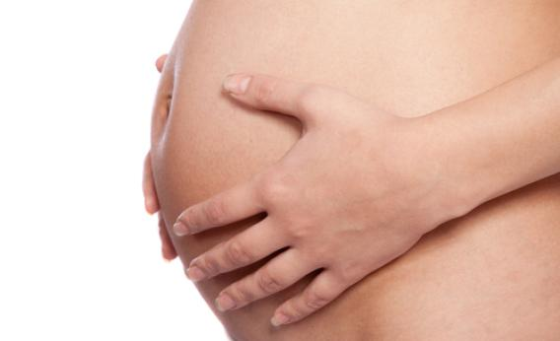
Prenatal Development
Prenatal: before birth; during or relating to pregnancy
Three stages:
Germinal
Embryonic
Fetal

Slide 9
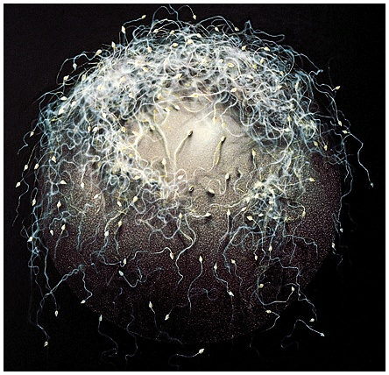
Germinal Stage
Begins at conception
Drop of an egg (female) and release of ~200 million sperm (male)
Sperm seeks out the egg to penetrate egg’s surface
That’s you.

Slide 10
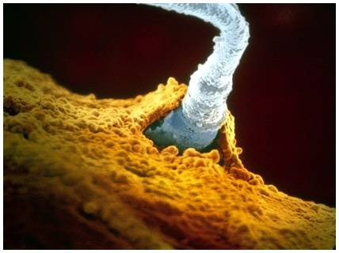
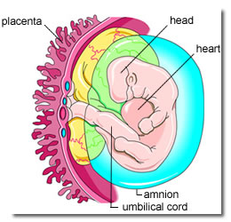
Germinal Stage
Once sperm penetrates the egg, a zygote is formed.
Zygote begins to divide
Differentiation occurs
10-14 days: attaches itself to wall of the uterus
Outer part: placenta
Inner part: embryo
cute kid…

Slide 11
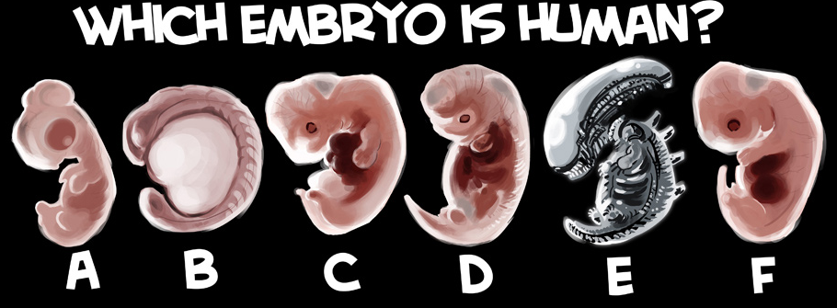

Slide 12
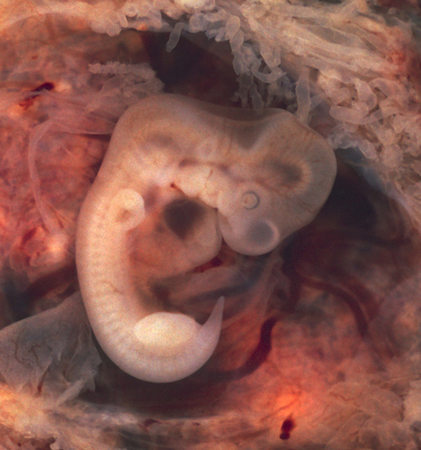
Embryonic Stage
Weeks 2-8
Embryo is 1½ inches long
Testosterone produced by testes = male
No testosterone = female
Heart begins to beat; organs begin to develop

Slide 13
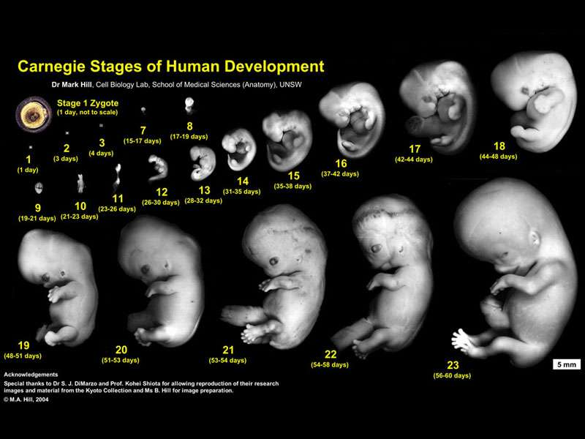

Slide 14
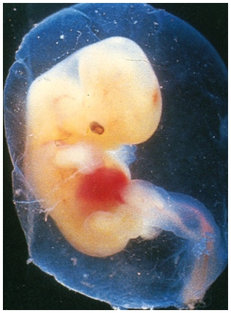
Fetal Stage
8 weeks to birth
Further develops organs
By 6th month, the stomach and other organs have formed enough to survive outside of mother.
Baby can hear (and recognize) sounds and respond to light.

Slide 15
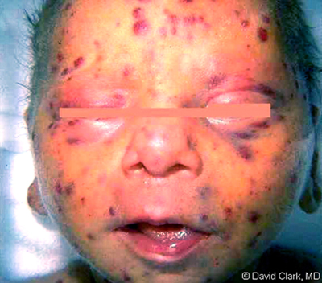
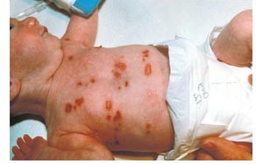
Fetal Stage
Can be negatively impacted by…
German measles
X-rays
Chemicals
STDs
Cigarette smoking
Alcohol consumption
Drugs
Baby exposed to genital herpes virus

Slide 16
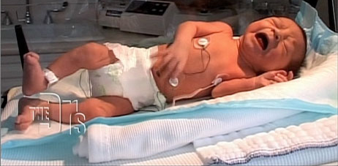
Drug Addicted Babies
WARNING: Content may be too graphic for some. If you prefer to wait in the hall, please do so now.
http://www.youtube.com/watch?v=80oJMZHjQTA

Slide 17
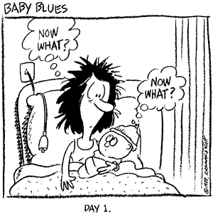
Finally…
TA DA!

