Slide 1
Myers’ PSYCHOLOGY (7th Ed)
Prologue:
The Story of Psychology
James A. McCubbin, PhD
Clemson University
Worth Publishers

Slide 2
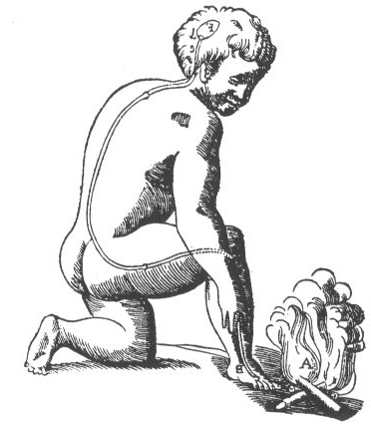
Prologue: Psychology’s Roots
Prescientific Psychology
Is the mind connected to the body or distinct?
Are ideas inborn or is the mind a blank slate filled by experience?

Slide 3
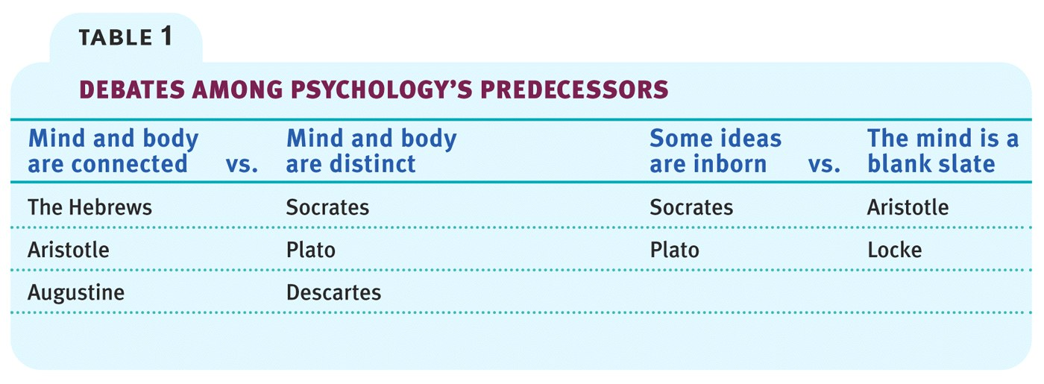
Prologue: Psychology’s Roots

Slide 4
Prologue: Psychology’s Roots
Psychological Science Is Born
Empiricism
Knowledge comes from experience via the senses
Science flourishes through observation and experiment

Slide 5
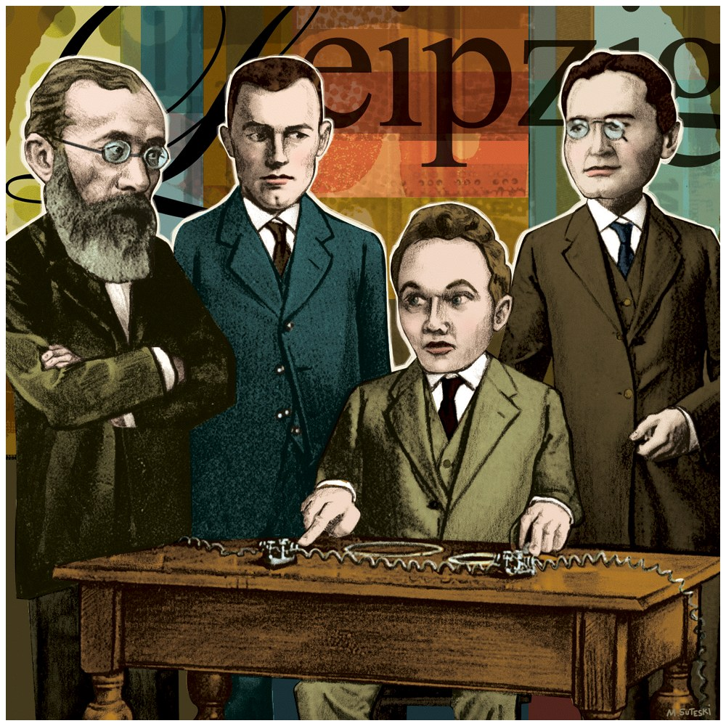
Prologue: Psychology’s Roots
Wilhelm Wundt opened the first psychology laboratory at the University of Liepzig (c. 1879)

Slide 6
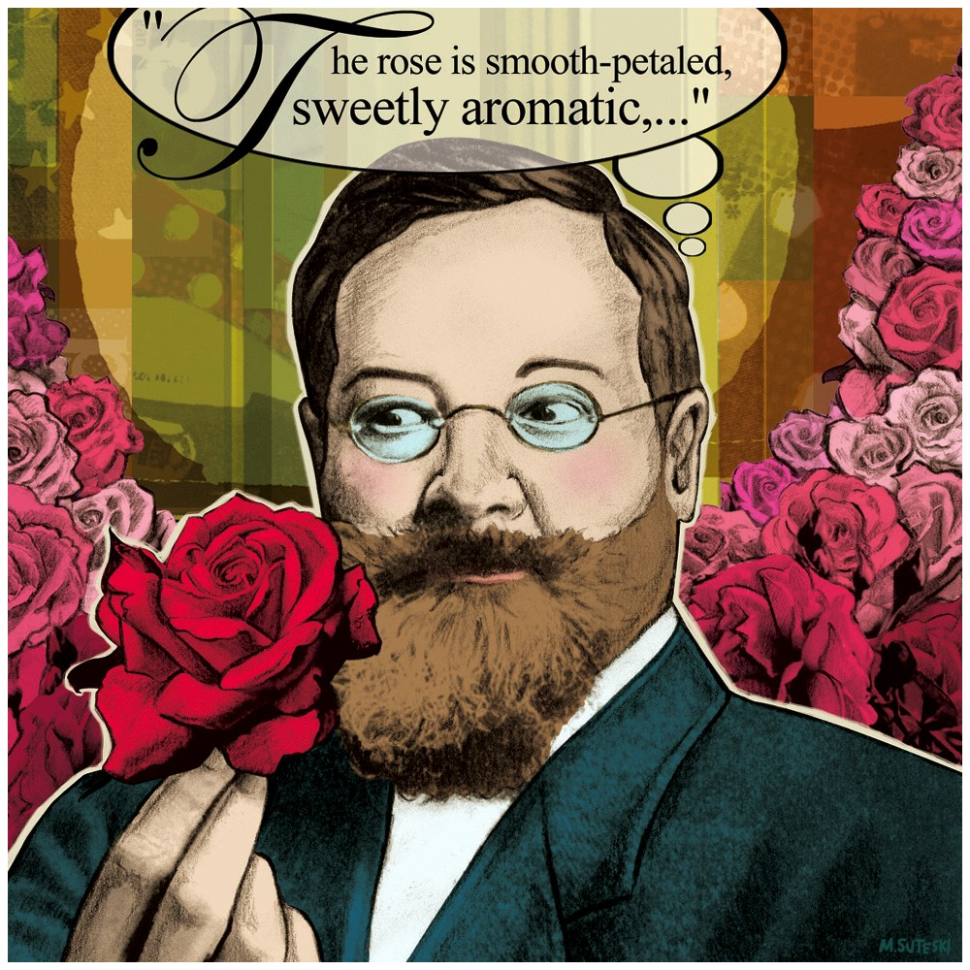
Prologue: Psychology’s Roots
Structuralism used introspection (looking in) to explore the elemental structure of the human mind

Slide 7
Prologue: Psychology’s Roots
Functionalism focused on how behavioral processes function- how they enable organism to adapt, survive, and flourish

Slide 8
Prologue: Psychology’s Roots
Psychological Science Develops
Wundt--German philosopher and physiologist
James--American philosopher
Pavlov--Russian physiologist
Freud--Austrian physician
Piaget--Swiss biologist

Slide 9
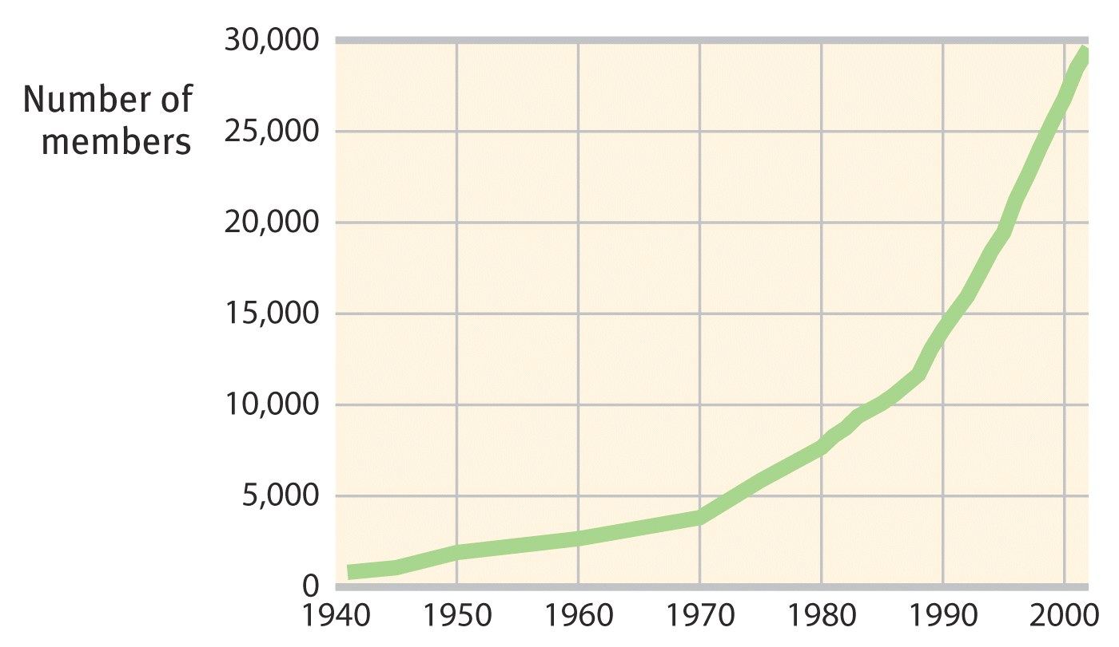
Prologue: Psychology’s Roots
Figure 1- British Psychological Society membership

Slide 10
Prologue: Psychology’s Roots
Definition of Psychology
The science of behavior (what we do) and mental processes (sensations, perceptions, dreams, thoughts, beliefs, and feelings)

Slide 11
Prologue: Contemporary Psychology
Psychology’s Big Issues
Nature-nurture controversy
the relative contribution that genes and experience make to development of psychological traits and behaviors

Slide 12
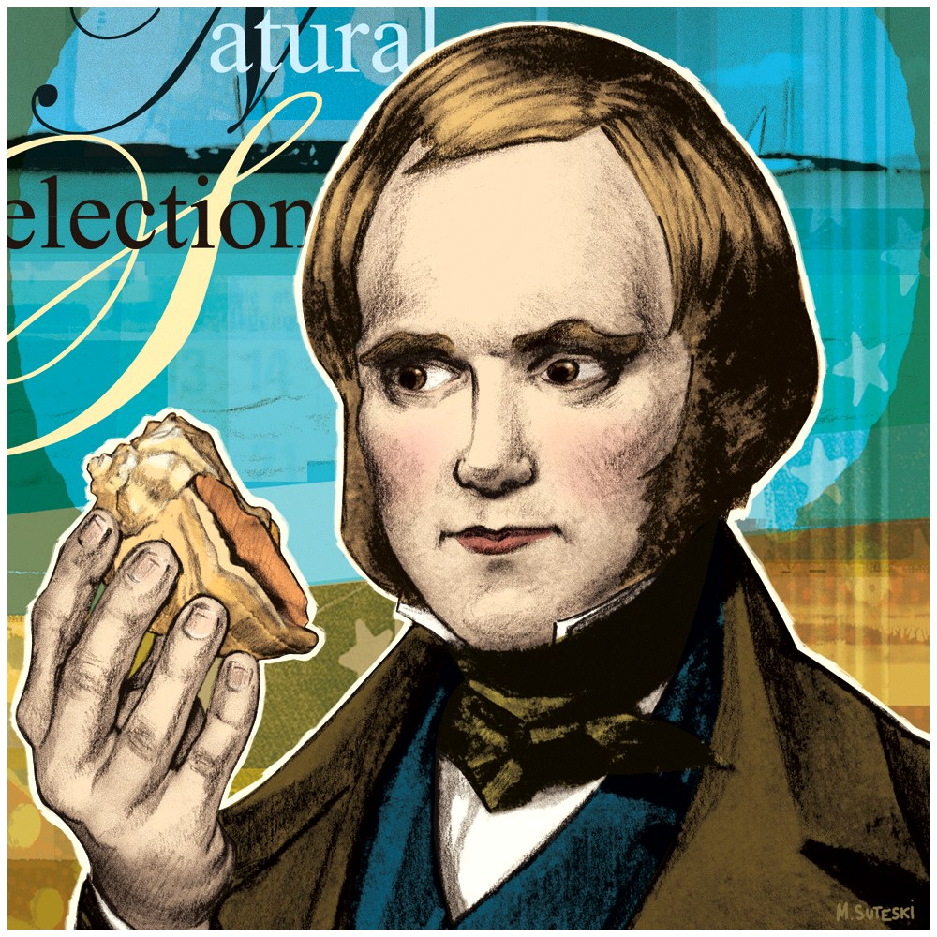
Prologue: Contemporary Psychology
Natural selection
principle that those inherited trait variations contributing to survival will most likely be passed on to succeeding generations

Slide 13
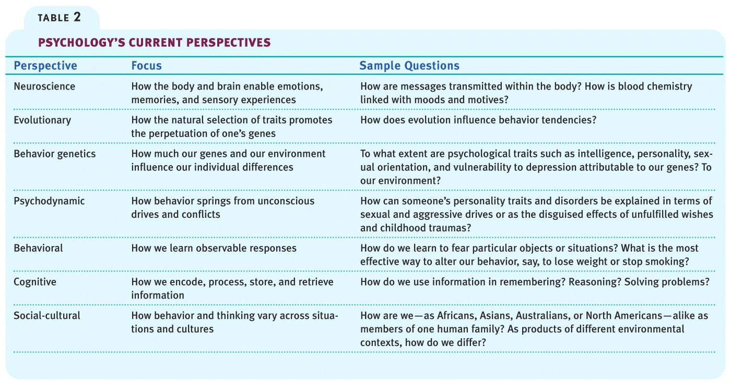
Prologue: Contemporary Psychology
Psychology’s Perspectives

Slide 14
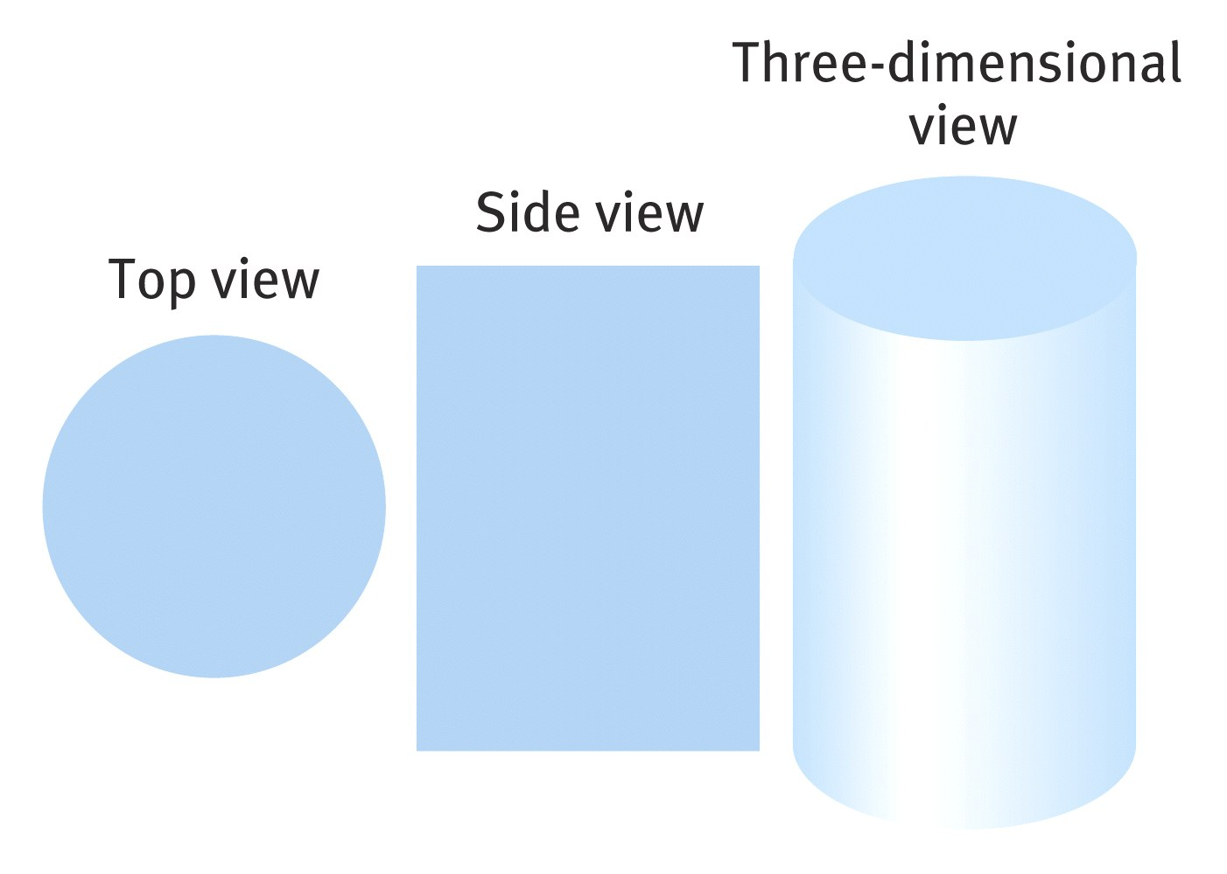
Prologue: Contemporary Psychology
Psychology’s Perspectives
A lot depends on your viewpoint

Slide 15
Prologue: Contemporary Psychology
Psychology’s Subfields
Basic Research
Biological psychologists explore the links between brain and mind
Developmental psychologists study changing abilities from womb to tomb
Cognitive psychologists study how we perceive, think, and solve problems

Slide 16
Prologue: Contemporary Psychology
Psychology’s Subfields
Basic Research
Personality psychologists investigate our persistent traits
Social psychologists explore how we view and affect one another

Slide 17
Prologue: Contemporary Psychology
Psychology’s Subfields
Applied Research
Industrial/organizational psychologists study and advise on behavior in the workplace
Clinical psychologists study, assess, and treat people with psychological disorders

Slide 18
Prologue: Contemporary Psychology
Psychiatry
A branch of medicine dealing with psychological disorders
Practiced by physicians who sometimes use medical (for example, drug) treatments as well as psychotherapy

