Slide 1
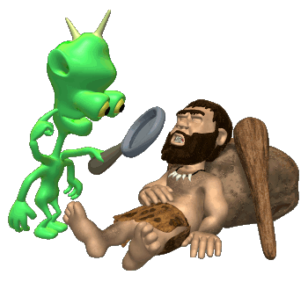
Research Methods
It is actually way more exciting than it sounds!!!!

Slide 2
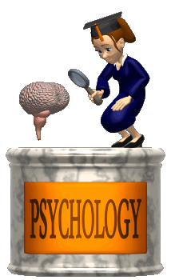
Why do we have to learn this stuff?
Psychology is first and foremost a science.
Thus it is based in research.
Before we delve into how to do research, you should be aware of three hurdles that tend to skew our logic.

Slide 3
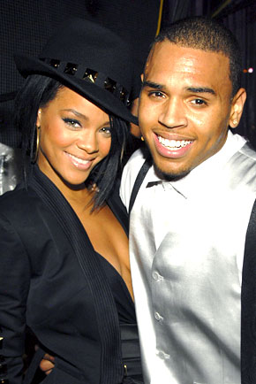
Hindsight Bias
The tendency to believe, after learning the outcome, that you knew it all along.
Monday Morning Quarterbacking!!!
After the Chris Brown/Rihanna incident….my wife said she knew Chris Brown was a violent kid!!! Did she really?

Slide 4
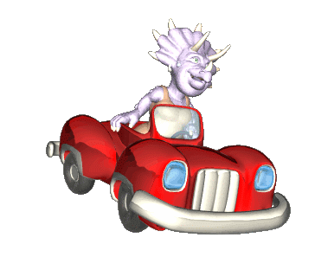
Overconfidence
We tend to think we know more than we do.
82% of U.S. drivers consider themselves to be in the top 30% of their group in terms of safety.
81% of new business owners felt they had an excellent chance of their businesses succeeding. When asked about the success of their peers, the answer was only 39%. (Now that's overconfidence!!!)

Slide 5
The Barnum Effect
It is the tendency for people to accept very general or vague characterizations of themselves and take them to be accurate.

Slide 6
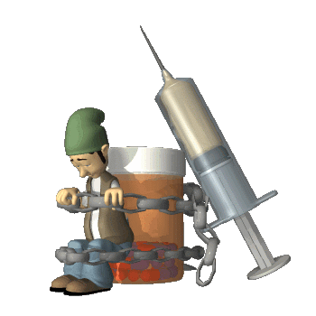
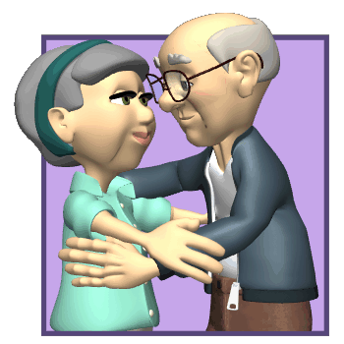
Applied V. Basic Research
Applied Research has clear, practical applications.
YOU CAN USE IT!!!
Basic Research explores questions that you may be curious about, but not intended to be immediately used.
Studying how kissing changes when you get older is interesting…but that’s about it.
Research on therapies for drug addicts has a clear purpose.

Slide 7
Terminology

Slide 8
Hypothesis
Expresses a relationship between two variables.
A variable is anything that can vary among participants in a study.
Participating in class leads to better grades than not participating.

Slide 9
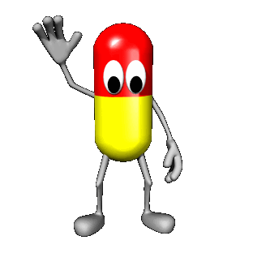
Independent Variable
Whatever is being manipulated in the experiment.
Hopefully the independent variable brings about change.
If there is a drug in an experiment, the drug is almost always the independent variable.

Slide 10
Dependent Variable
Whatever is being measured in the experiment.
It is dependent on the independent variable.
The dependent variable would be the effect of the drug.

Slide 11
Operational Definitions
Explain what you mean in your hypothesis.
How will the variables be measured in “real life” terms.
How you operationalize the variables will tell us if the study is valid and reliable.
Let’s say your hypothesis is that chocolate causes violent behavior.
What do you mean by chocolate?
What do you mean by violent behavior?

Slide 12
Sampling
Identify the population you want to study.
The sample must be representative of the population you want to study.
GET A RANDOM SAMPLE.
Stratified Sampling

Slide 13
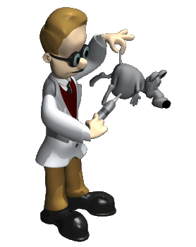
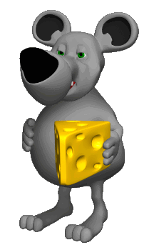
Experimental Method
Looking to prove causal relationships.
Cause = Effect
Laboratory v. Field Experiments
Smoking causes health issues.

Slide 14
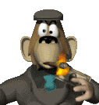
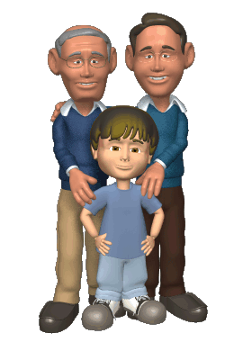
Beware of Confounding Variables
The object of an experiment is to prove that A causes B.
A confounding variable is anything that could cause change in B, that is not A.
If I wanted to prove that smoking causes heart issues, what are some confounding variables?
Lifestyle and family history may also effect the heart.

Slide 15
Random Assignment
Once you have a random sample, randomly assigning them into two groups helps control for confounding variables.
Experimental Group v. Control Group.
Group Matching

Slide 16
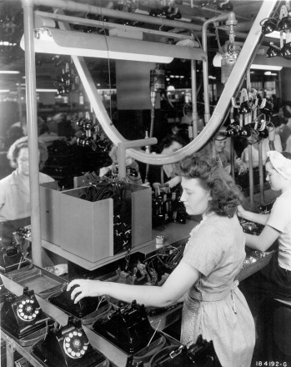
Hawthorne Effect
But even the control group may experience changes.
Just the fact that you know you are in an experiment can cause change.
Whether the lights were brighter or dimmer, production went up in the Hawthorne electric plant.

Slide 17
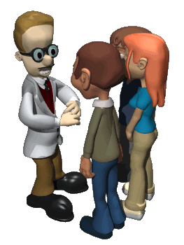
Experimenter Bias
Another confounding variable.
Not a conscious act.
Double-Blind Procedure.

Slide 18
Other Confounding Variables
Placebo effect
Order Effects

Slide 19
Correlational Method
Correlation expresses a relationship between two variable.
Does not show causation.
As more ice cream is eaten, more people are murdered.
Does ice cream cause murder, or murder cause people to eat ice cream?

Slide 20
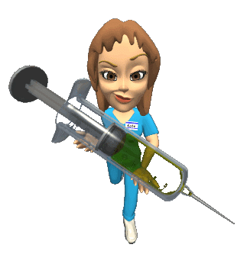
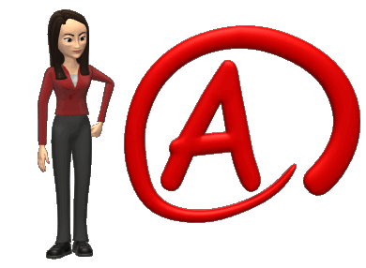
Types of Correlation
Negative Correlation
The variables go in opposite directions.
Positive Correlation
The variables go in the SAME direction.
Studying and grades hopefully has a positive correlation.
Heroin use and grades probably has a negative correlation.

