Slide 1
Survey Method
Most common type of study in psychology
Measures correlation
Cheap and fast
Need a good random sample
Low-response rate

Slide 2
Naturalistic Observation
Watch subjects in their natural environment.
Do not manipulate the environment.
The good is that there is Hawthorne effect.
The bad is that we can never really show cause and effect.

Slide 3
Correlation Coefficient
A number that measures the strength of a relationship.
Range is from -1 to +1
The relationship gets weaker the closer you get to zero.
Which is a stronger correlation?
-.13 or +.38
-.72 or +.59
-.91 or +.04

Slide 4
Case Studies
A detailed picture of one or a few subjects.
Tells us a great story…but is just descriptive research.
Does not even give us correlation data.
The ideal case study is John and Kate. Really interesting, but what does it tell us about families in general?

Slide 5
Statistics
Recording the results from our studies.
Must use a common language so we all know what we are talking about.

Slide 6
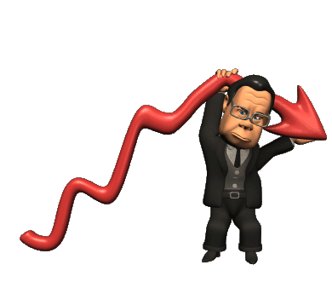
Descriptive Statistics
Just describes sets of data.
You might create a frequency distribution.
Frequency polygons or histograms.

Slide 7
Central Tendency
Mean, Median and Mode.
Watch out for extreme scores or outliers.
Let’s look at the salaries of the employees at Dunder Mifflen Paper in Scranton:
$25,000-Pam
$25,000- Kevin
$25,000- Angela
$100,000- Andy
$100,000- Dwight
$200,000- Jim
$300,000- Michael
The median salary looks good at $100,000.
The mean salary also looks good at about $110,000.
But the mode salary is only $25,000.
Maybe not the best place to work.
Then again living in Scranton is kind of cheap.

Slide 8
Normal Distribution
In a normal distribution, the mean, median and mode are all the same.

Slide 9
Distributions
Outliers skew distributions.
If group has one high score, the curve has a positive skew (contains more low scores)
If a group has a low outlier, the curve has a negative skew (contains more high scores)

Slide 10
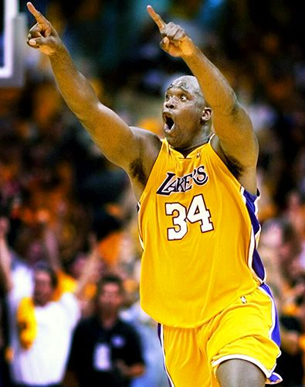
Other measures of variability
Range: distance from highest to lowest scores.
Standard Deviation: the variance of scores around the mean.
The higher the variance or SD, the more spread out the distribution is.
Do scientists want a big or small SD?
Shaq and Kobe may both score 30 ppg (same mean).
But their SDs are very different.

Slide 11
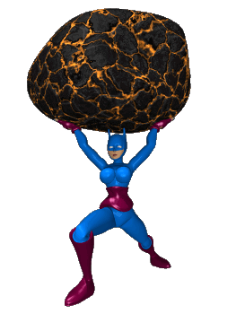
Scores
A unit that measures the distance of one score from the mean.
A positive z score means a number above the mean.
A negative z score means a number below the mean.

Slide 12
Normal Distribution

Slide 13
Inferential Statistics
The purpose is to discover whether the finding can be applied to the larger population from which the sample was collected.
T-tests, ANOVA or MANOVA
P-value= .05 for statistical significance.
5% likely the results are due to chance.

Slide 14
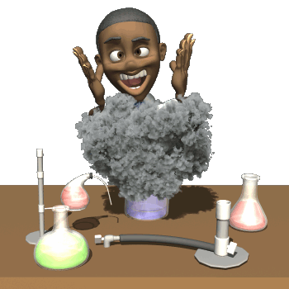
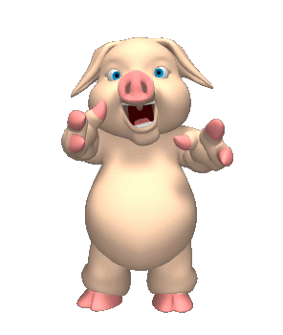
APA Ethical Guidelines for Research
IRB- Internal Review Board
Both for humans and animals.

Slide 15
Animal Research
Clear purpose
Treated in a humane way
Acquire animals legally
Least amount of suffering possible.

Slide 16
Human Research
No Coercion- must be voluntary
Informed consent
Anonymity
No significant risk
Must debrief

