Slide 1
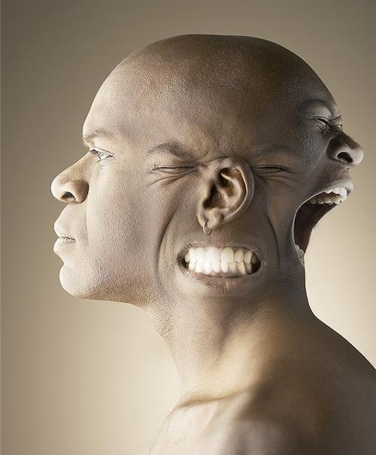
Personality

Slide 2
“Trait Perspective”
No hidden personality dynamics, just basic personality dimensions!
Traits—people’s characteristic behaviors and conscious motives
How do we describe and classify different personalities?
Type A vs. Type B
Depressed vs. Cheerful
Describe 5 of Homer’s traits

Slide 3
Trait Theories of Personality
Believe we can describe people’s personality by specifying their main characteristics (traits)
Traits like honesty, laziness, ambition, independence are thought to be stable over your lifetime.

Slide 4
Are there “Basic” Traits?
Combination of 2 or 3 genetically determined dimensions
Extraversions vs. Introversion
Emotional Stability vs. Emotional Instability
Expanded set of factors
“The Big Five”

Slide 5
“The Big Five”
Imaginative/Practical
Independent/Conforming
Openness
Organized/Disorganized
Careful/Careless
Conscientiousness
Extraversion
Sociable/Retiring
Fun Loving/Sober
Agreeableness
Soft-Hearted/Ruthless
Trusting/Suspicious
Neuroticism
(Emotional Stability)
Calm/Anxious
Secure/Insecure

Slide 6
Rate Your Traits!
For each item, write a number from 1 to 7 indicating the extent to which you see that trait as being characteristic of you, where…
1 = “I disagree strongly that this trait describes me.”
to
7 = “I agree strongly that this trait describes me.”
Test designed by Samuel D. Gosling

Slide 7
Extroverted, enthusiastic
Critical, argumentative
Dependable, self-disciplined
Anxious, easily upset
Open to new experiences, complex
Reserved, quiet
Sympathetic, warm
Disorganized, careless
Calm, emotionally stable
Conventional, uncreative

Slide 8
Score Yourself!
Extroversion: High on Q1, Low on Q6
Emotional instability: High on Q4, Low on Q9
Nice: High on Q7, Low on Q2
Careful: High on Q3, Low on Q8
Openness: High on Q5, Low on Q10

Slide 9
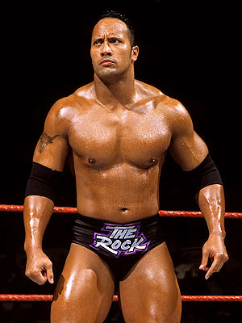
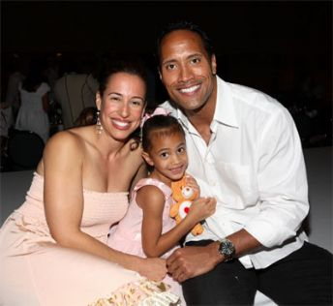
Trait Theory Criticism
Do NOT take into account the importance of the situation.
People act differently when placed in different situations!
Dwayne Johnson at
work
Dwayne Johnson
at home →

Slide 10
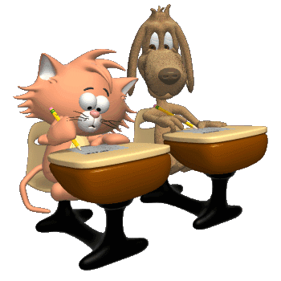
Assessing Personality Today
Most common way is self-report inventories
MMPI: Minnesota Multiphasic Personality Inventory
Tests must be…
Reliable: Does it yield the same results over time?
Valid: Does it measure what it is supposed to measure?

Slide 11
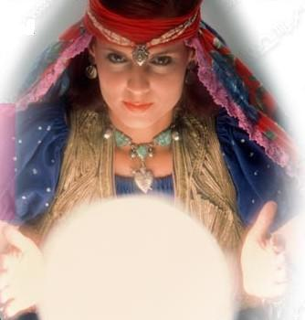
Be careful of the Barnum Effect!
People have tendency to see themselves in vague, general descriptions of personality
Horoscopes, astrologers, and psychics capitalize on the Barnum Effect!

Slide 12
Horoscopes
VAGUE

Slide 13
Sample MMPI Questions True/ False
1.I like mechanics magazines 2.I have a good appetite 3.I wake up fresh & rested most mornings 4.I think I would like the work of a librarian 5.I am easily awakened by noise 6.I like to read newspaper articles on crime 7.My hands and feet are usually warm enough 8.My daily life is full of things that keep me interested 9.I am about as able to work as I ever was 10.There seems to be a lump in my throat much of the time 11.A person should try to understand his dreams and be guided by or take warning from them 12.I enjoy detective or mystery stories 13.I work under a great deal of tension 14.I have diarrhea once a month or more 15.Once in a while I think of things too bad to talk about 16.I am sure I get a raw deal from life 17.My father was a good man 18.I am very seldom troubled by constipation 19.When I take a new, I like to be tipped off on whom should be gotten next to 20.My sex life is satisfactory 21.At times I have very much wanted to leave home 22.At times I have fits of laughing & crying that I cannot control 23.I am troubled by attacks of nausea and vomiting 24.No one seems to understand me 25.I would like to be a singer 26.I feel that it is certainly best to keep my mouth shut when I’m in trouble 27.Evil spirits possess me at times 28.When someone does me a wrong I feel I should pay him back if I can, just for the principle of the thing. 29.I am bothered by acid stomach several times a week 30.At times I feel like swearing 31.I have nightmares every few nights 32.I find it hard to keep my mind on a task or job 33.I have had very peculiar and strange experiences 34.I have a cough most of the time 35.If people had not had it in for me I would have been much more successful 36.I seldom worry about my heath 37.I have never been in trouble because of my sex behavior 38.During one period when I was a youngster I engaged in petty thievery
39.At times I feel like smashing things 40.Most any time I would rather sit and daydream than to do anything else 41.I have had periods of days, weeks, or months when I couldn’t take care of things because I couldn’t “get going” 42.My family does not like the work I have chosen ( or the work I intend to choose for my life work) 43.My sleep is fitful and disturbed 44.Much of the time my head seems to hurt all over 45.I do not always tell the truth 46.My judgment is better than it ever was 47.Once a week or oftener I feel suddenly hot all over without apparent cause 48.When I am with people I am bothered by hearing very queer things 49.It would be better if almost all laws were thrown away 50.My soul sometimes leaves my body 51.I am in just as good physical health as most of my friends 52.I prefer to pass by school friends, or people I know but have not seen for a long time, unless they speak to me first 53.A minister can cure disease by praying and putting his hand on your head 54.I am liked by most people who know me 55.I am almost never bothered by pains over the heart or in my chest 56.As a youngster I was suspended from school one or more times for cutting up 57.I am a good mixer 58.Everything is turning out just like the prophets of the Bible said it would 59.I have often had to take orders from someone who did not know as much as I did 60.I do not read every editorial in the newspaper everyday 61.I have not lived the right kind of life 62.Parts of my body often have feeling like burning, tingling, crawling, or like “going to sleep” 63.I have had no difficulty in starting or holding my bowel movement 64.I sometimes keep on at a thing until others lose their patience with me 65.I loved my father 66.I see things or animals or people around me that others do not see 67.I wish I could be as happy as others seem to be 68.I hardly ever feel pain in the back of the neck 69.I am very strongly attracted by members of my own sex 70.I used to like drop-the-handkerchief 71.I think a great many people exaggerate their misfortunes in order to gain the sympathy and help of others 72.I am troubled by discomfort in the pit of my stomach every few days or oftener 73.I am an important person 74.I have often wished I were a girl. (Or if you are a girl) I have never been sorry that I am a girl 75.I get angry sometimes

