Slide 1
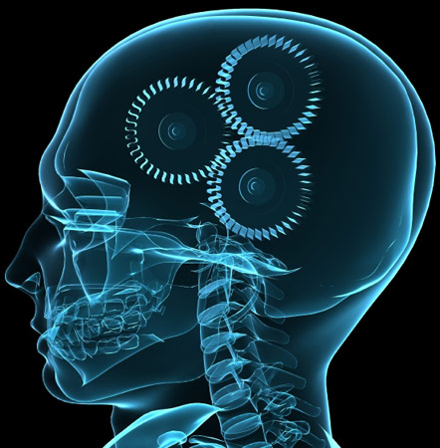
What is Psychology?

Slide 2
Definition of Psychology
The scientific study of behavioral and mental processes.

Slide 3
Why Study Psychology?
Psychology provides tools to help us gain insight into our behavior as well as our relationships with others.

Slide 4
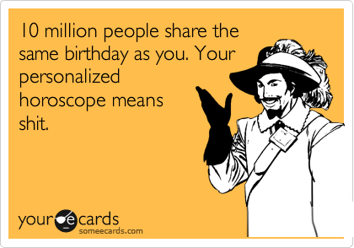
What Psychology IS NOT…
Psychology IS NOT a pseudoscience
Greek for “false science”
Examples: Horoscopes, Astrology, Phrenology
*

Slide 5
Fields of Psychology
A psychologist is someone who is trained to observe and influence behavior in people.
A psychiatrist is a medical doctor that can prescribe medicine for psychological illnesses.

Slide 6
Work in Psychology
Elementary/
Secondary
Schools
4.2%
Universities &
Colleges
27.2%
Independent
Practice
33.1%
Hospitals,
Counseling,
Clinics, etc.
22.3%
Business,
Government or
Consulting
12.1%

Slide 7
Psychological vs. Physiological
Psychological needs are things like love, comfort, security
Physiological needs are things like food, water, sleep

Slide 8
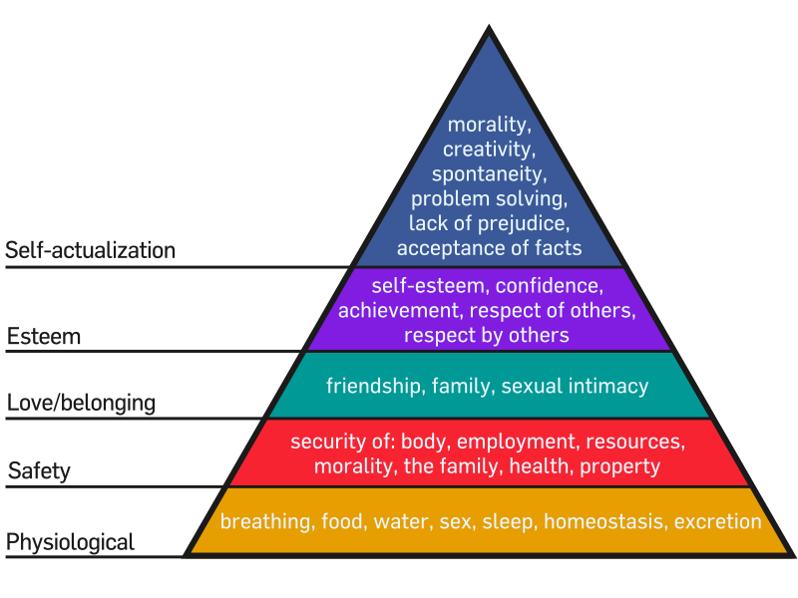
Maslow’s Hierarchy of Needs

Slide 9
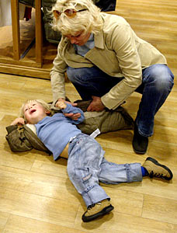
Four Goals of Psychology
DESCRIPTION: The kid is having a meltdown in the candy aisle
EXPLANATION: He wants the yummy candy
PREDICTION: He will get the candy
INFLUENCE: Strategically-placed candy bars
Notes:
Wal-Mart knows that moms have already lost patience with their kids by the time they get to the checkout line, so they put the candy there to get the kids to wear mom down to buy the candy

Slide 10
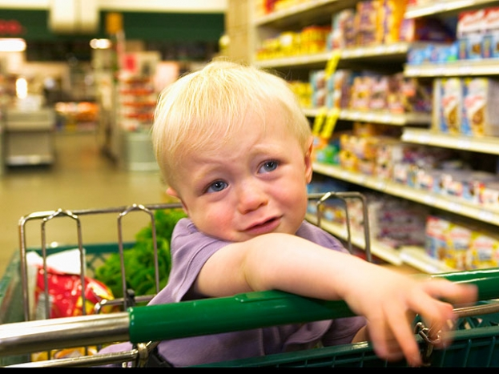
1.) Description
Observable behavior
What do you see?
Does not offer the “why” actions are happening

Slide 11
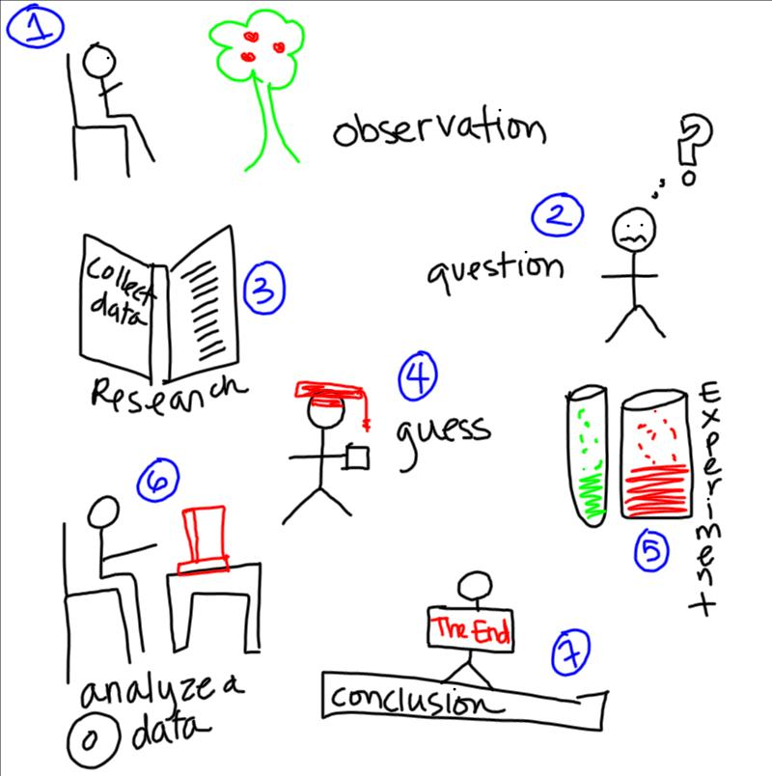
2.) Explanation
Psychology is empirical
Empirical: information is obtained through observation and experimentation, NOT “common sense,” intuition, or guessing.

Slide 12
2.) Explanation
Psychology is a behavioral science.
Psychologists rely on the scientific method to obtain their data.

Slide 13
2.) Explanation
General research
Ex: Research on drug effects on the brain
Basic Science
Applied Science
Psychology
Putting general research to use for a specific purpose
Ex: Using research on how drugs effect the brain to come up with a new antidepressant to help people suffering from depression

Slide 14
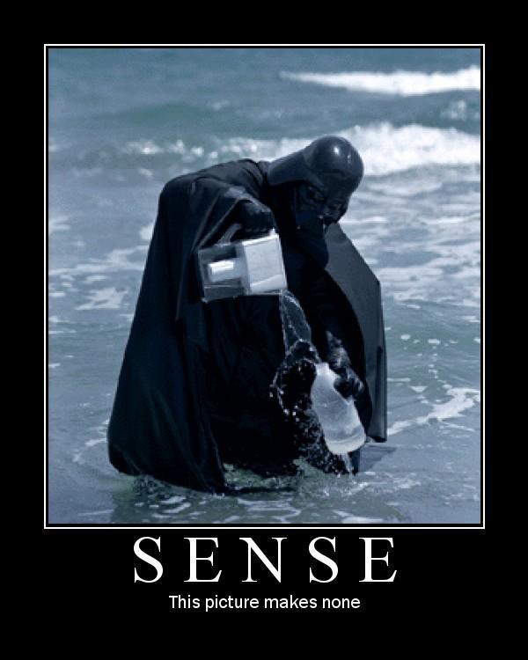
3.) Prediction
By accumulating knowledge, we are able to predict what people or animals will or think in certain situations and predict future behaviors

Slide 15
3.) Prediction
A theory is a proposed explanation. In psychology, we will be studying different theories.
A hypothesis is an educated guess. Demonstrates relationship between two variables.

Slide 16
4.) Influence
Scientists seek to influence behavior in helpful ways.
Chains like Wal-Mart have done these scientific observations and place candy as you check out because when your kid is screaming, sometimes it is easier to just buy the candy bar.

